Slide 1
Route Analyst
Thousands of moving buses & trains
Millions of measurements
per second
Route Analyst stores this data indefinitely and analyzes it instantly
Route Analyst Uses Moonshadow’s DB4IoT Database Engine

Slide 2
Your CAD/AVL Data Isn’t Big Data, It’s Bigger Data
TriMet Example
One Month of Data
700 buses
145 light rail
300,000 weekday trips
100 million trips/year
400,000 daily stops
200 values per bus
Measured every five seconds
Stored in 30,000 daily log files
Comprising 250 million records
Containing 50 billion values

Slide 3
Your CAD/AVL Data Isn’t Big Data, It’s Bigger Data
Vehicle Movement Data
60 MPH = 1 mile/minute = 27 meters/second
For <1 meter movement resolution, you need 50 measurements/second
Now TriMet’s one-month bus movement database is 60 Billion Records
1 Month of TriMet Bus Data = 1TB in DB4IoT
That is for only 845 vehicles

Slide 4
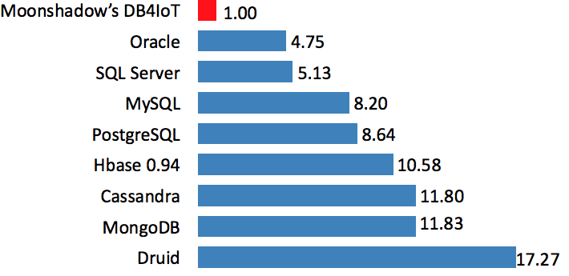
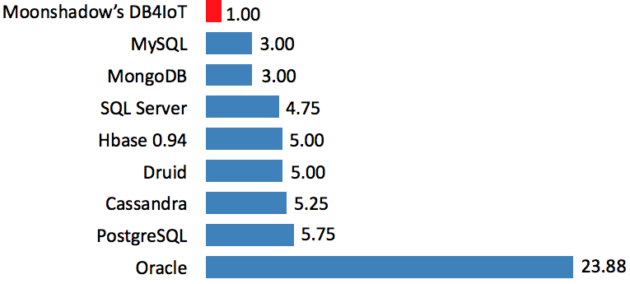
The Data is Too Large for Traditional Database Engines
DB4IoT Shrinks the Data Losslessly by 90%
Data Footprint Size
Data Row Overhead Size

Slide 5
Traditional Database Engines Are Too Slow
DB4IoT Speed Advantages
Fast Ingestion Speed 100k records/second/server
Low Ingestion Latency <150 ms
Small Data Footprint <1 byte/value, lossless
Fast Analytics Speed 200M records/second/cpu
Instant Maps 200M records 10x per sec
Software Only Runs on Intel X86 CPUs
Deployment In-Cloud
Patents Six issued, four pending

Slide 6
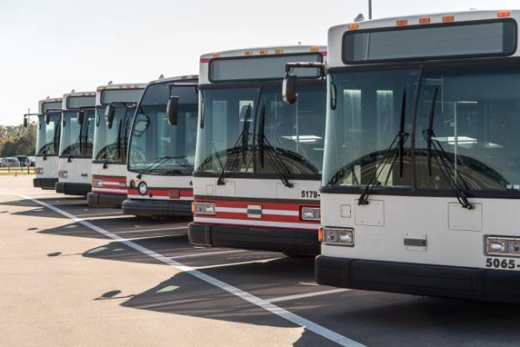
CAD/AVL Systems
Sensors
Gateway
Computer
Time, Location, Delay
Acceleration, Speed
Breaking, Lane Changes
Passenger Counts
Engine Diagnostics
Some data is transmitted from the buses in real time via a radio or cellular connection
Most of the data is stored on a computer located in the bus and uploaded once per day

Slide 7
Route Analyst Data Flow
AVL, Gateway
Real-Time Data
in your vehicle
CAD/AVL
Daily Log Files
in your vehicle
Driver
Mobile App
in your vehicle
Passenger Mobile App
in your vehicle
Cellular & Radio
Wi-Fi
Cellular
Cellular
in our cloud
API
API
API
Route Analyst GTFS
in your browser
Route Analyst CAD/AVL
in your browser
Custom Applications
in your browser

Slide 8
Route Analyst GTFS: from $199/month
GTFS
Service Schedule Route Shapes
on your servers
GTFS
Real Time Vehicle Position
on your servers
Checked Daily
Checked Every second
in our cloud
API
Route Analyst GTFS
in your browser

Slide 9
Route Analyst GTFS: $199/month
If Your Transit Agency Publishes:
GTFS Schedule & Shapes
GTFS Real-Time Vehicle Position
Then we can bring up Route Analyst GTFS
without involving your IT staff
The faster you update your data, the better the information gets
The more data you include in your feeds, the better it gets

Slide 10
Route Analyst GTFS is currently available for:
TransLink, Vancouver, BC
King Country Metro, Seattle, WA
WA State Ferries, Seattle, WA
Pierce Transit, Lakewood, WA
TriMet, Portland, OR
AC Transit, Oakland, CA
RTD, Denver, CO

Slide 11
Route Analyst GTFS Use Cases
Analyze Route Performance
Movement Playback
Find Data Errors
Grant Application Visuals
OpenGov: Publish Transit Data

Slide 12
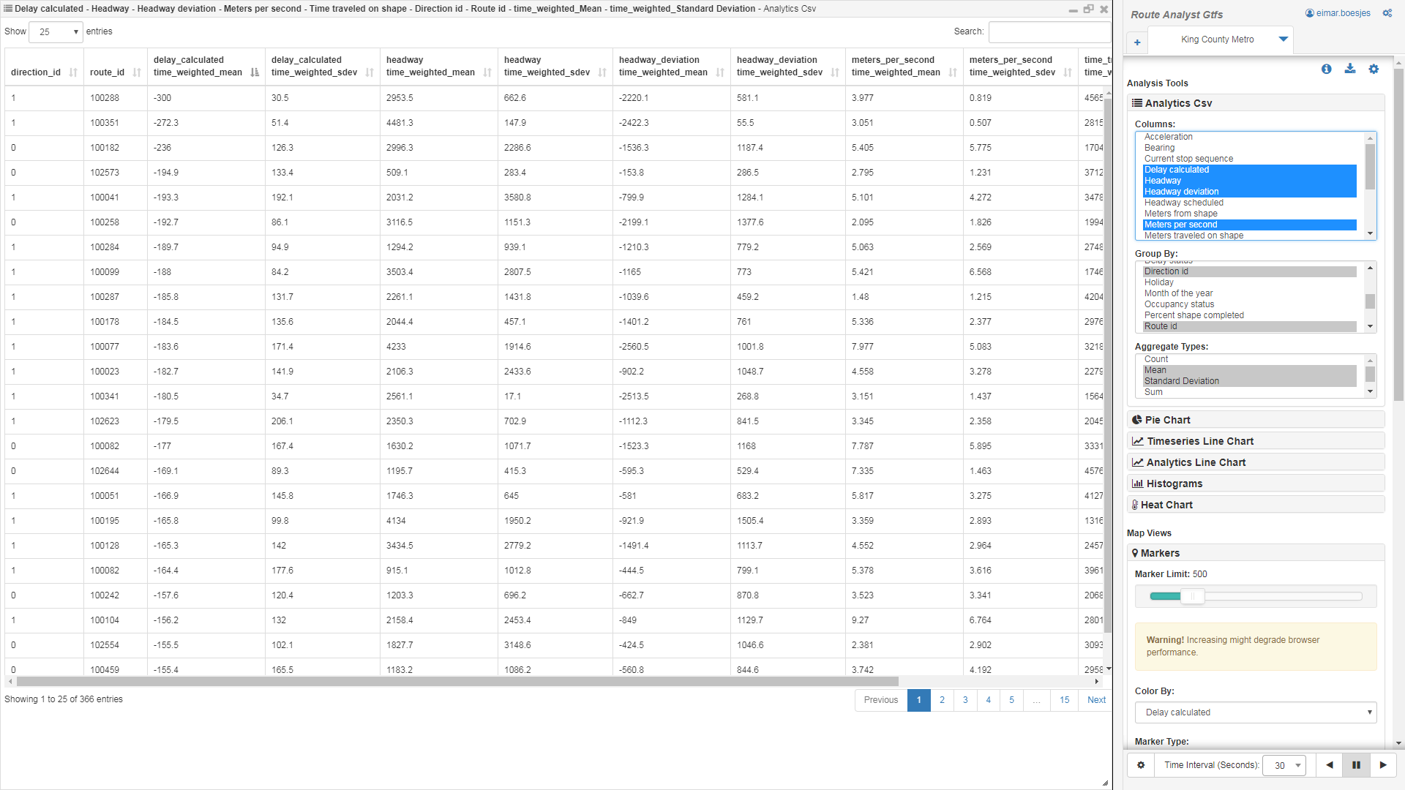
Route Performance: Delay per Route Direction

Slide 13
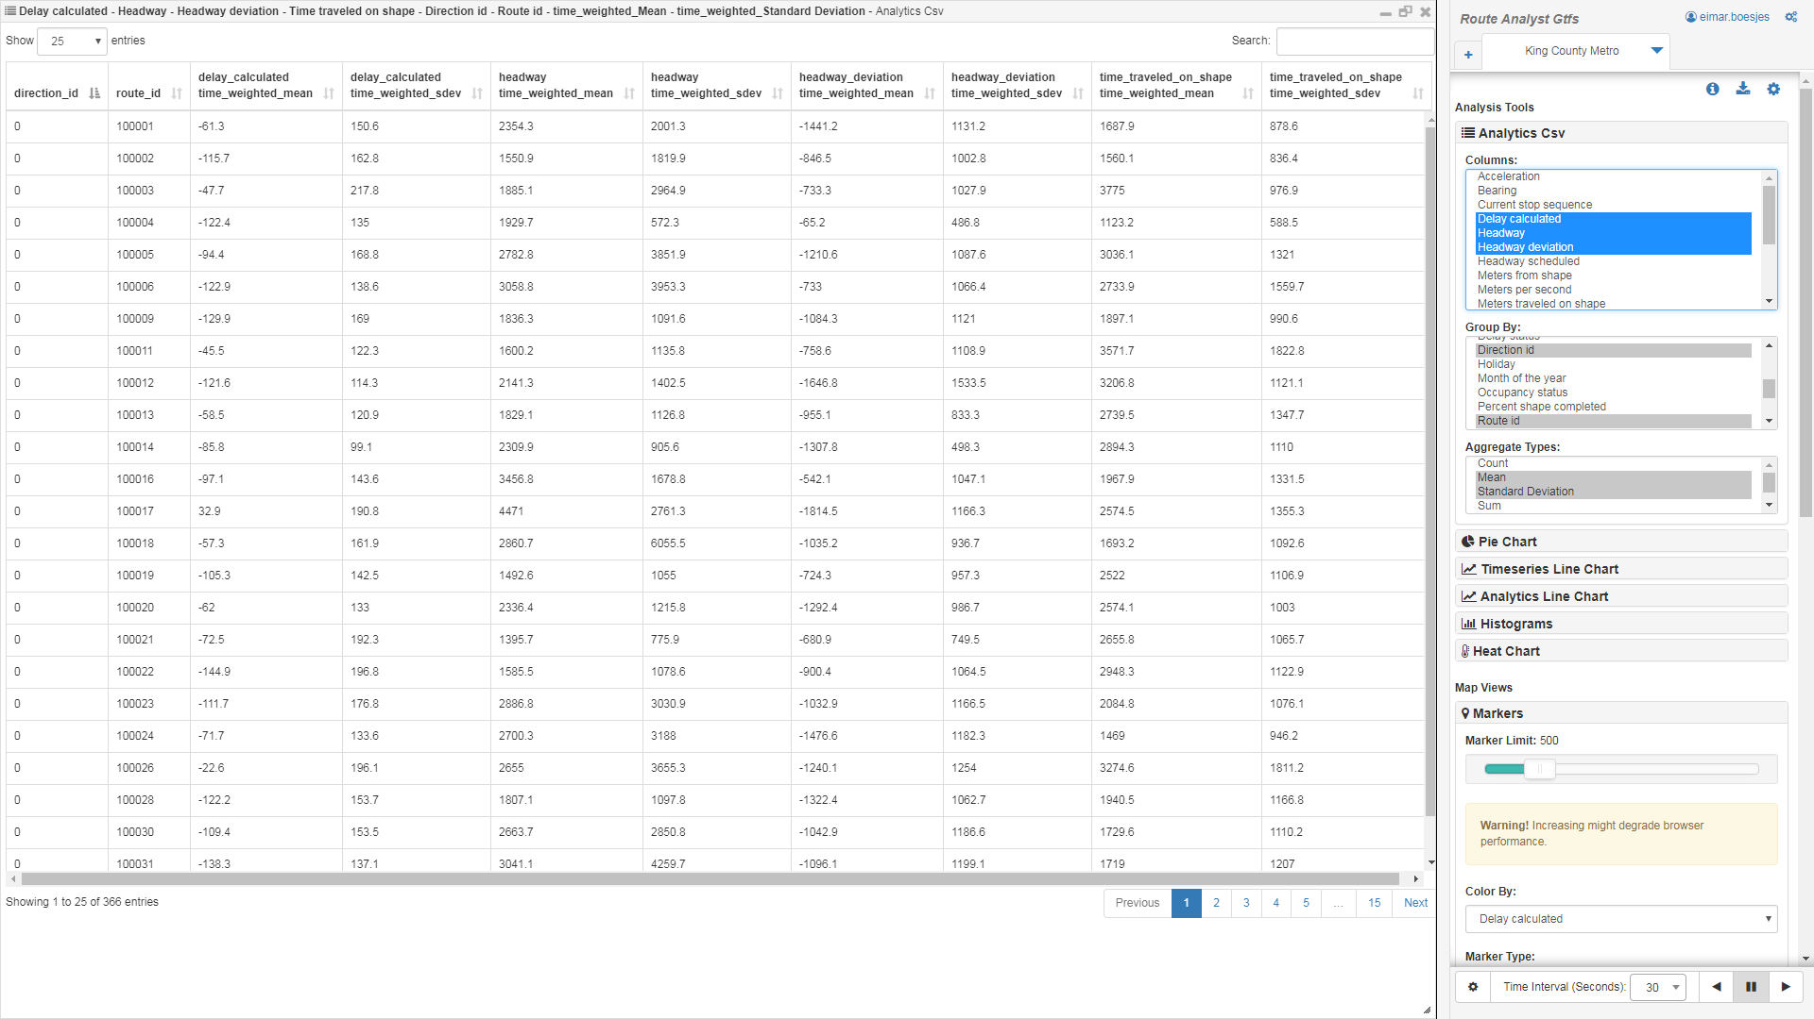
Route Performance: Weekday Headway Deviation

Slide 14
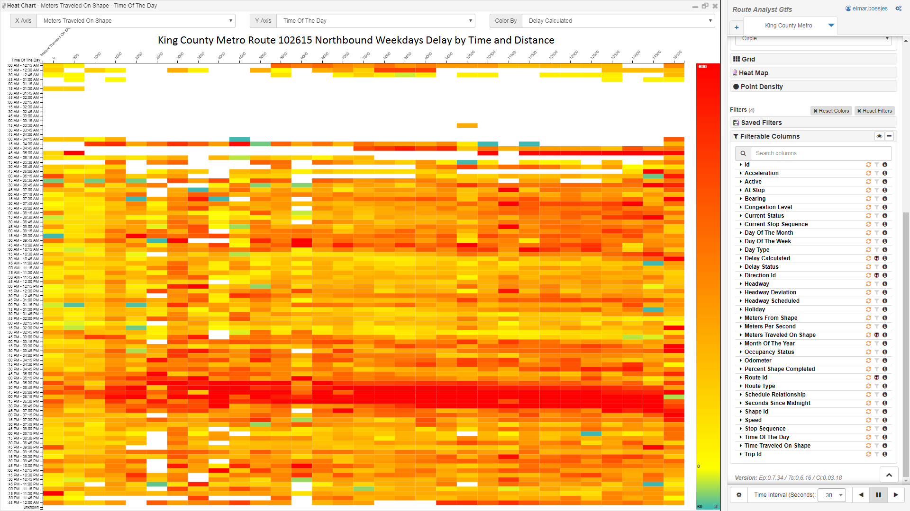
Route Performance: Weekday Delay by Time & Distance

Slide 15
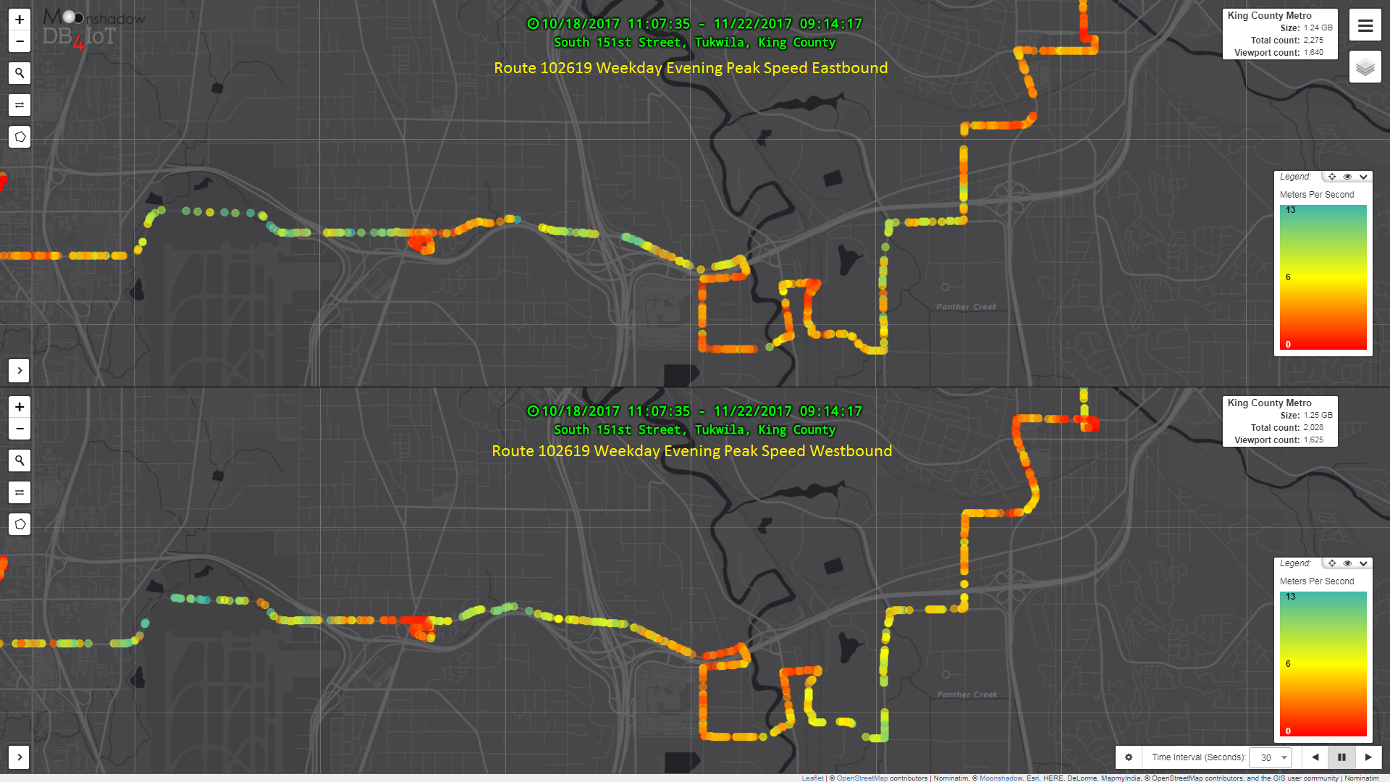
Route Performance: Evening Peak Speed Comparison

Slide 16
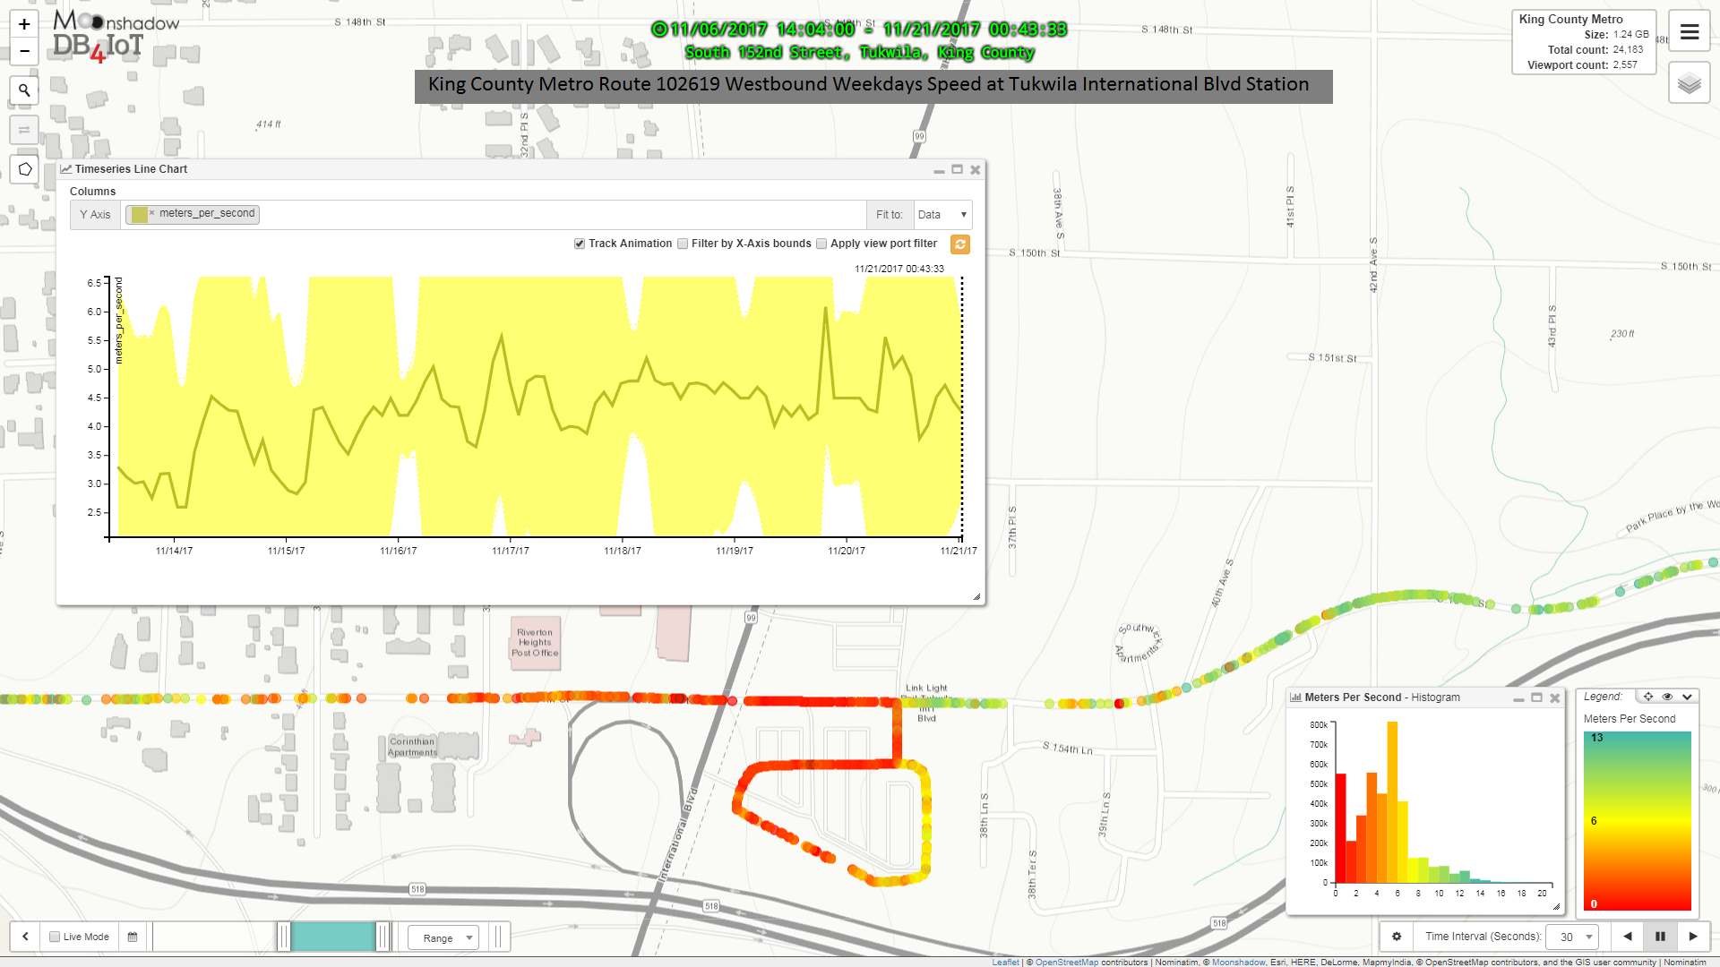
Route Performance: Detailed Speed Comparison

Slide 17
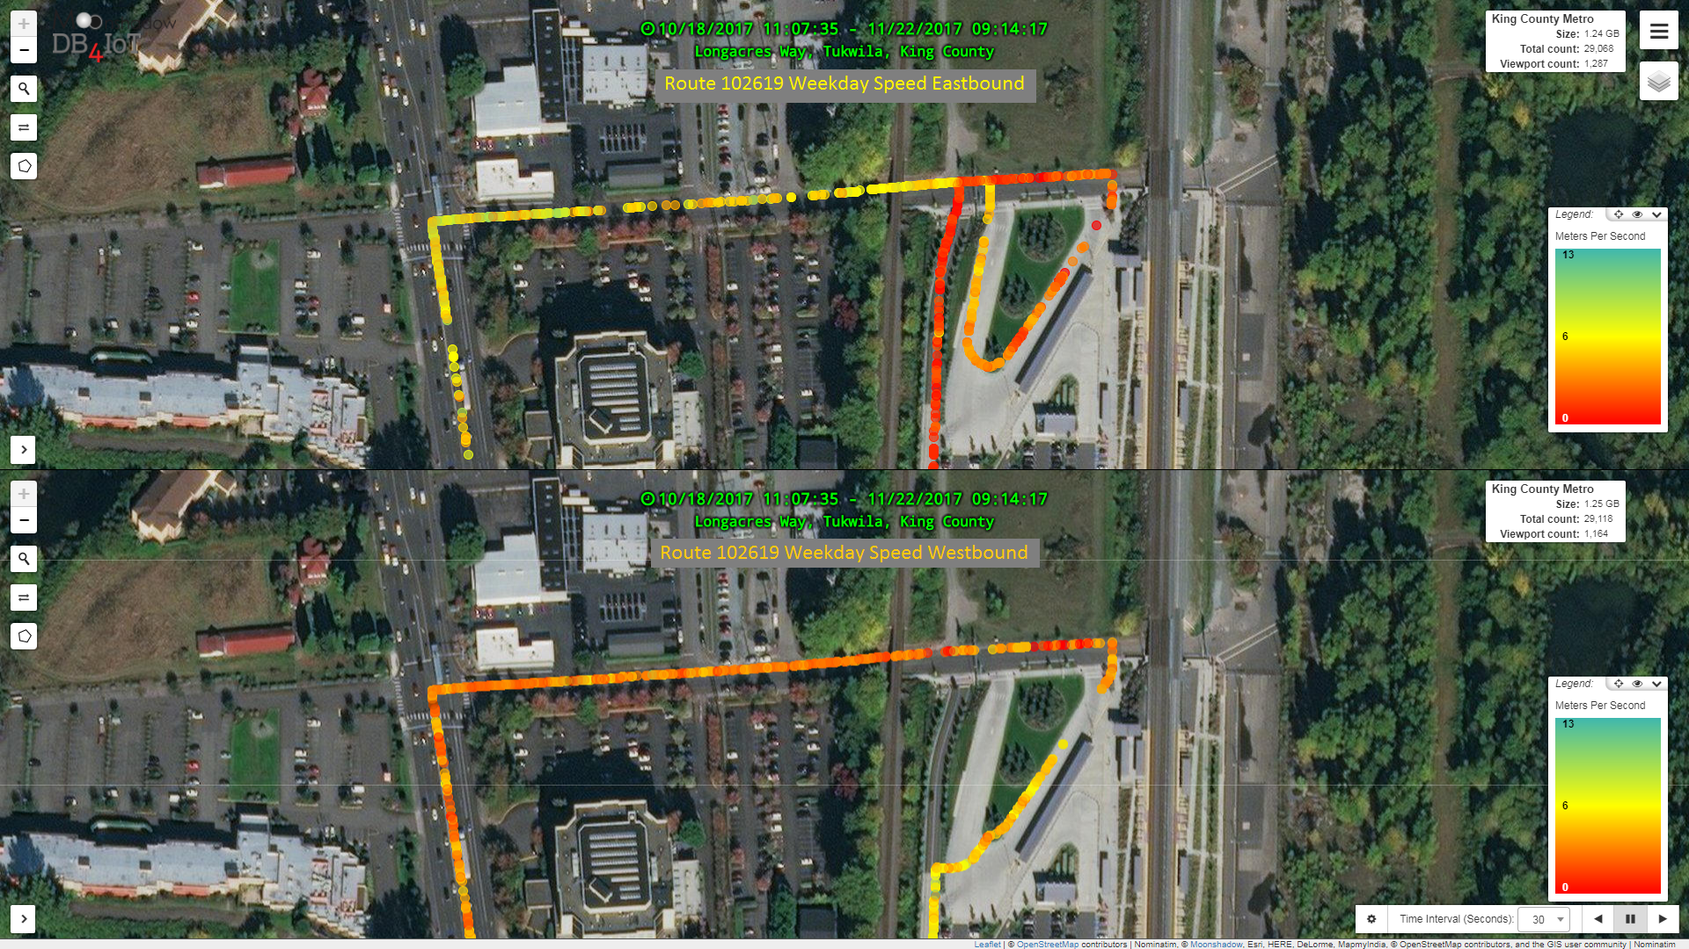
Route Performance: Detailed Speed Comparison

Slide 18
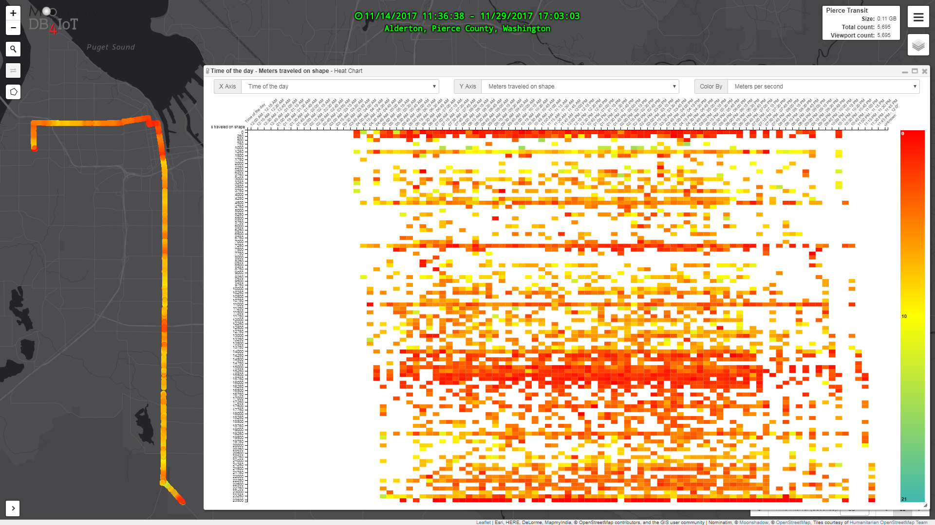
Route Performance: Speed Map & Chart

Slide 19
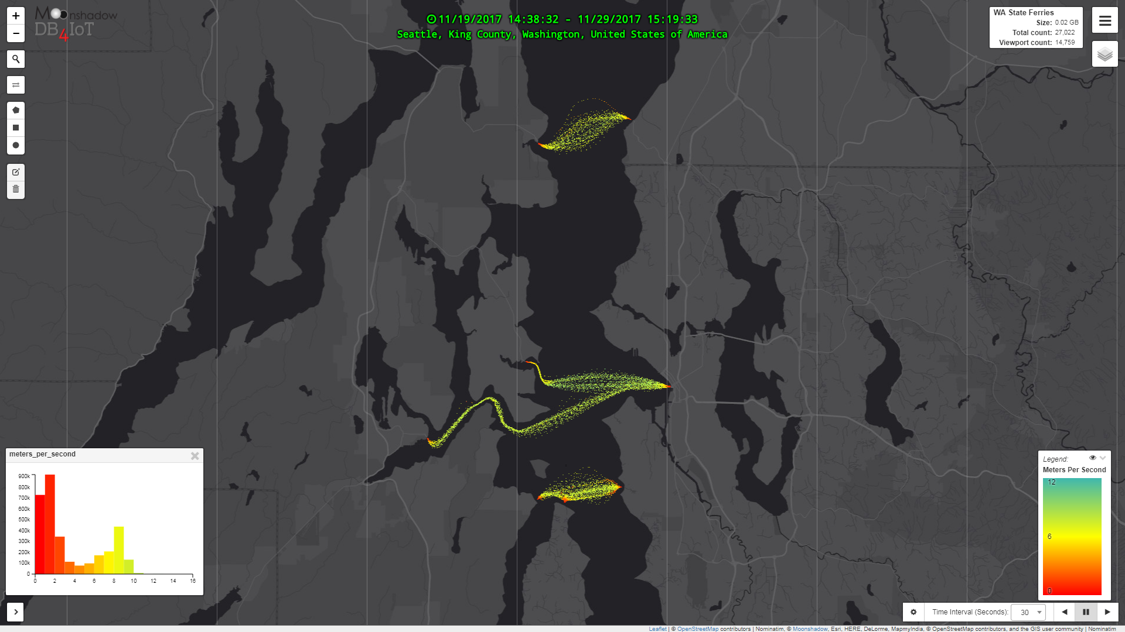
Movement: WA State Ferry Movement

Slide 20
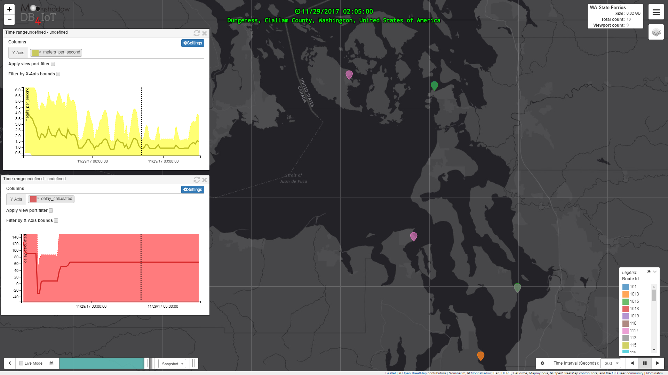
Movement Playback: State Ferry Movement
Click on this image to launch YouTube video

Slide 21
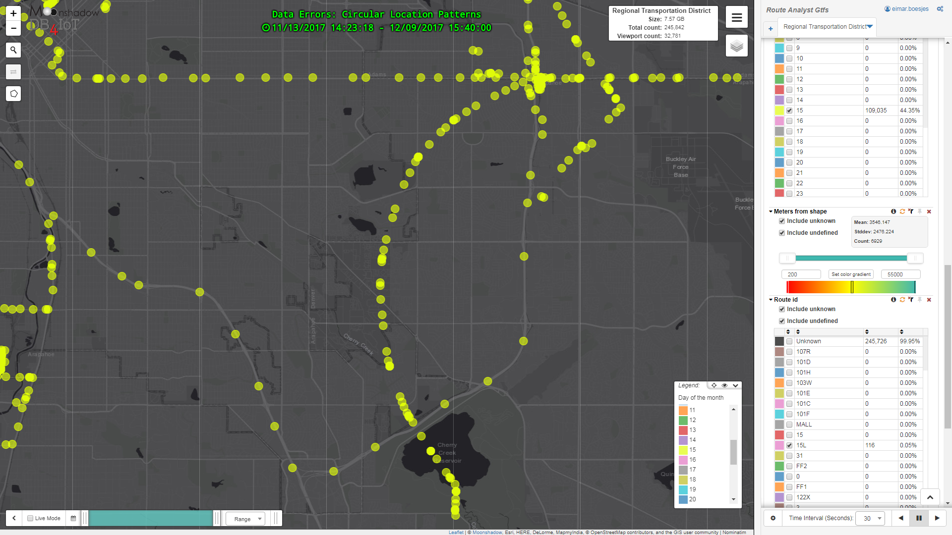
Find Data Errors

Slide 22
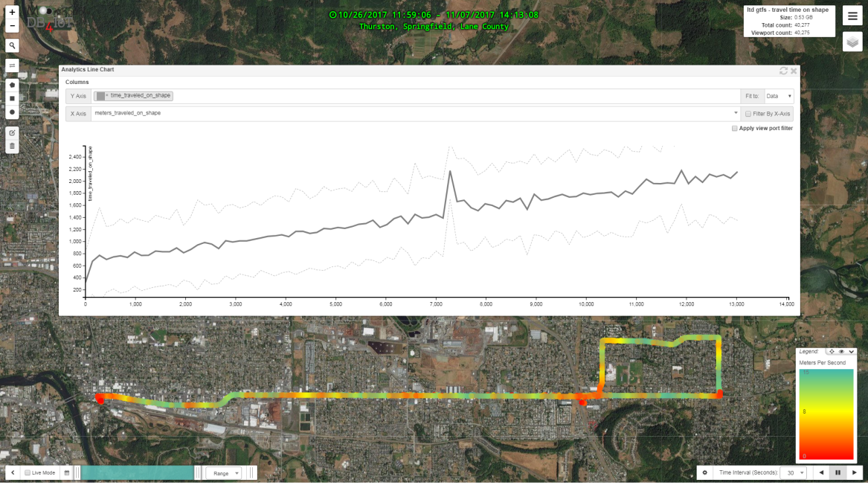
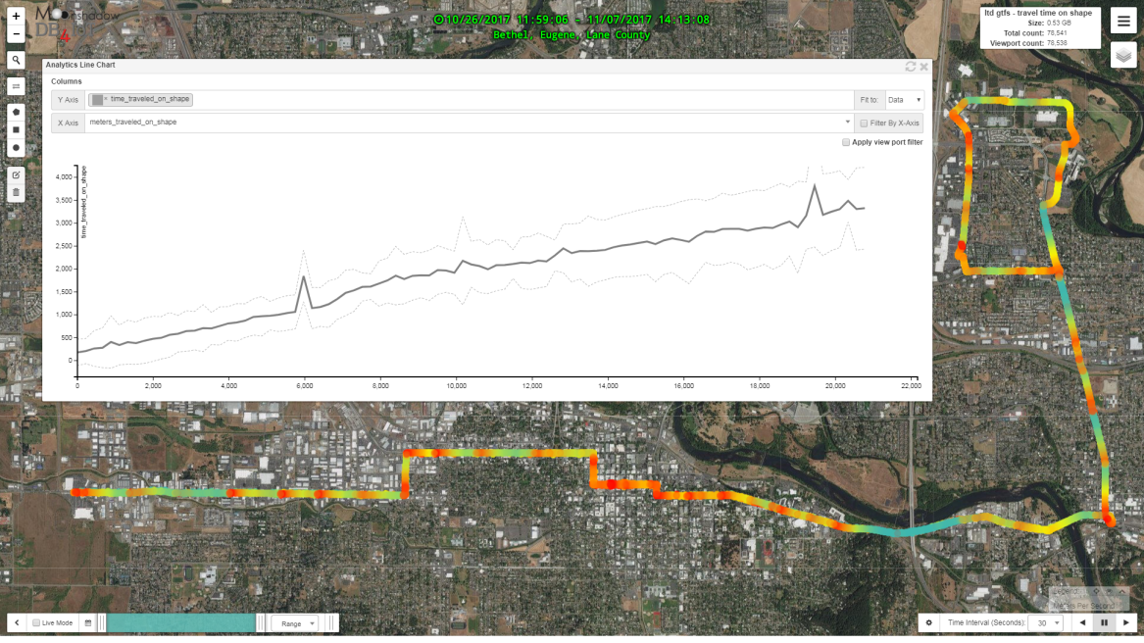
Grant Application Visuals: BRT Reliability Improvement
Dotted line = Standard Deviation = Reliability
Traditional
BRT

Slide 23
OpenGov: Publish Transit Data
AVL, Gateway
Real-Time Data
CAD/AVL
Daily Log Files
Driver
Mobile App
Passenger Mobile App
Cellular & Radio
Wi-Fi
Cellular
Cellular
Open API
Open API
Open API
Route Analyst GTFS
Route Analyst CAD/AVL
Custom Applications

Slide 24
Route Analyst CAD/AVL Use Cases
Corridor Studies
Before/After studies for TSP
Cellular Signal Performance
Ridership Analysis
Social Equity

Slide 25
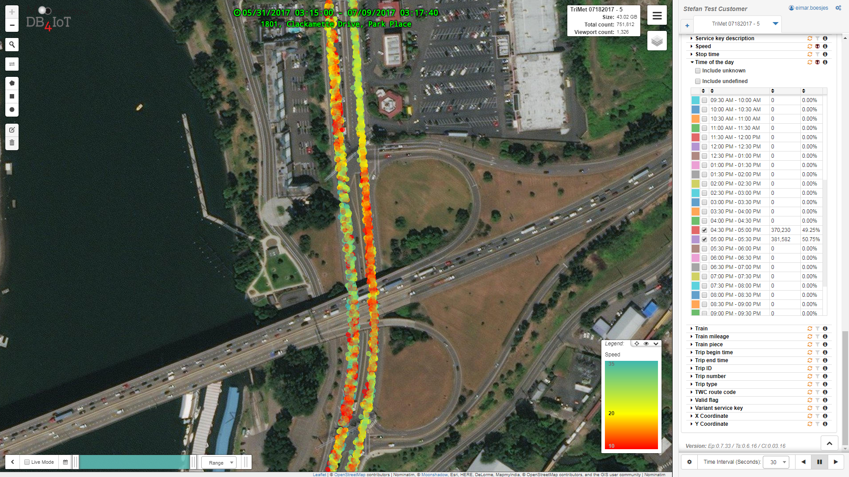
Corridor Studies: Peak Speed Analysis

Slide 26
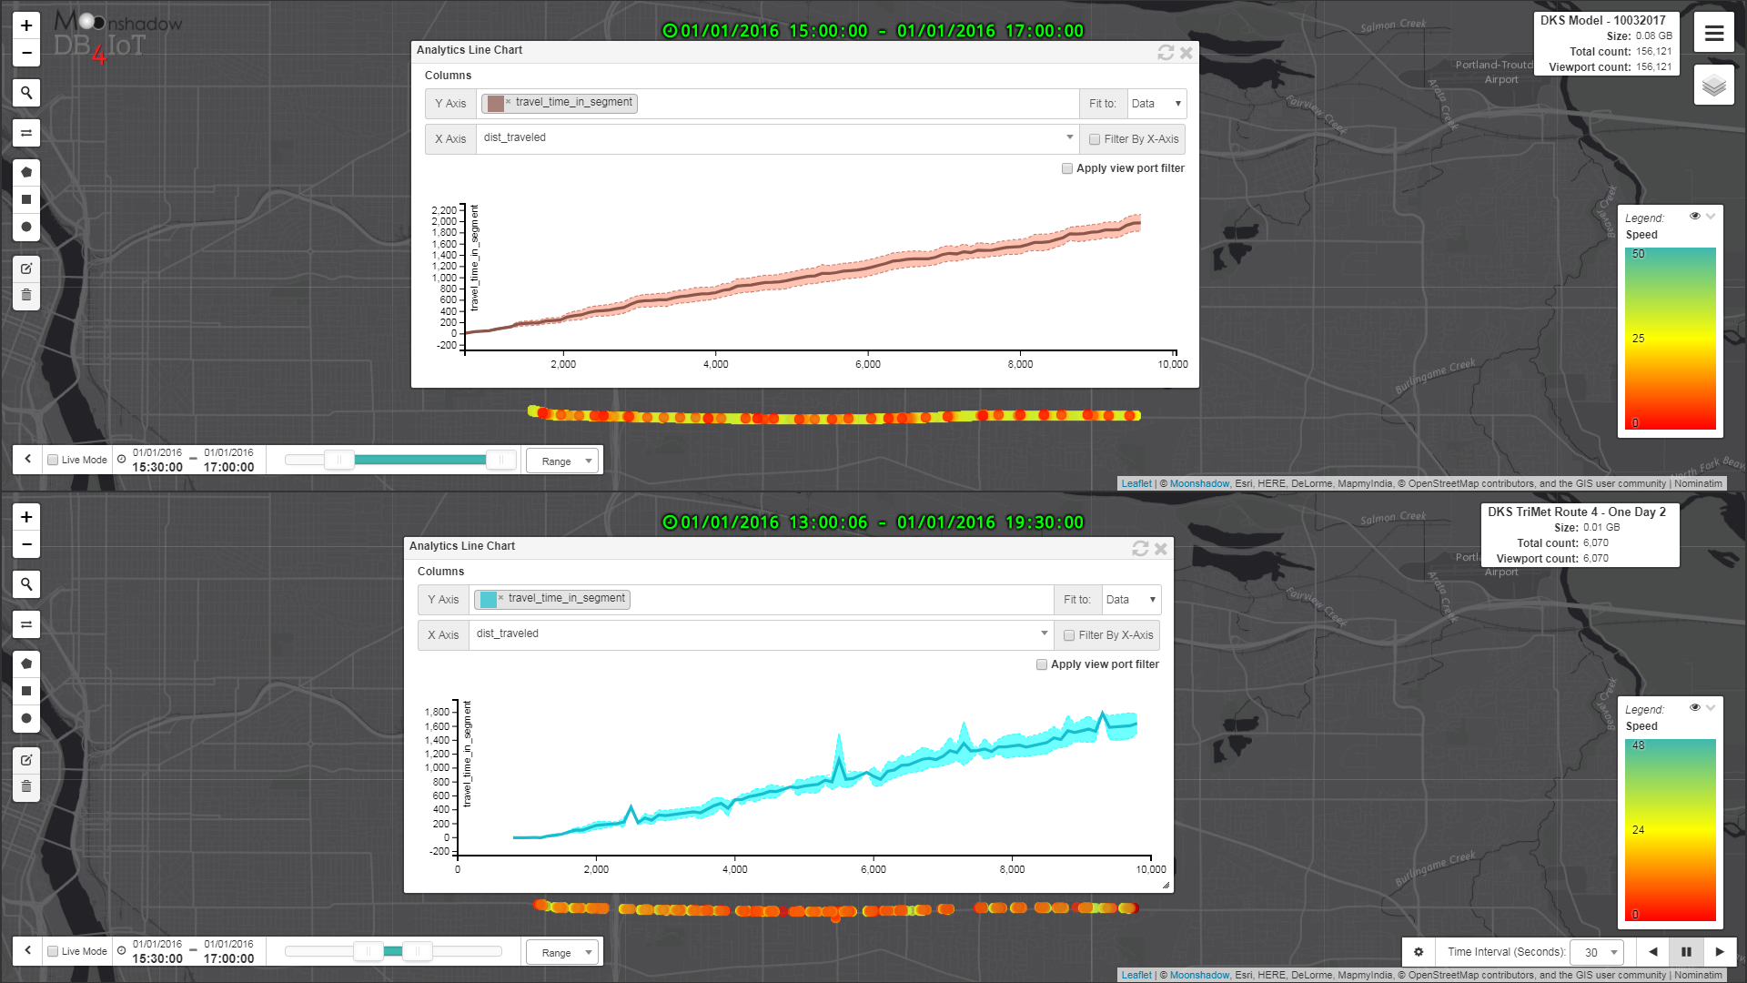
Corridor Studies: Model Calibration
NoBuild Vissim Model
Travel Times (Graph)
Speeds (Map)
Actual Measurements
Travel Times (Graph)
Speeds (Map)

Slide 27
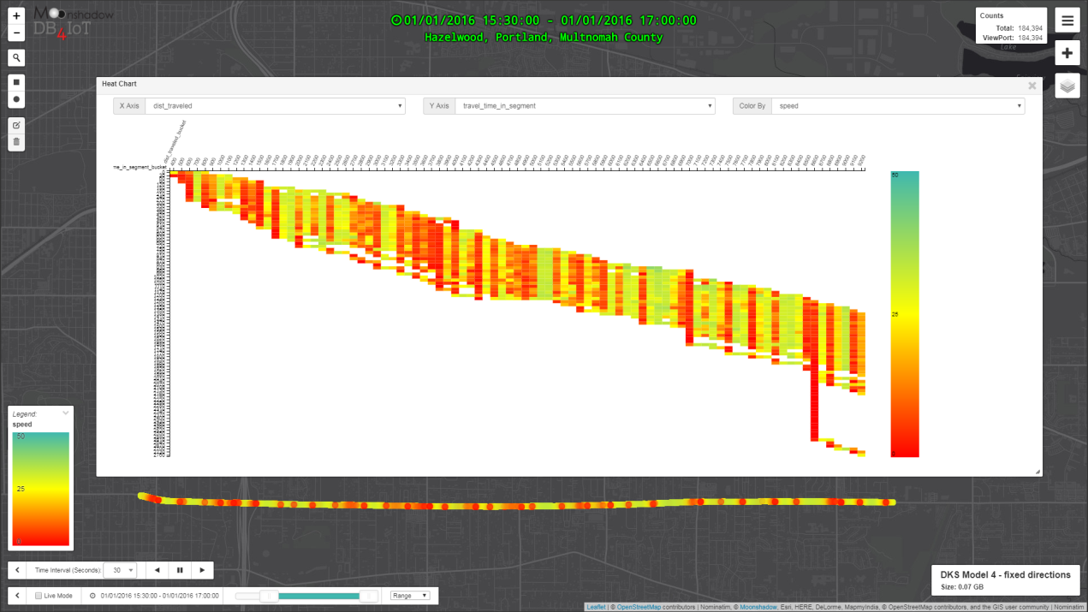
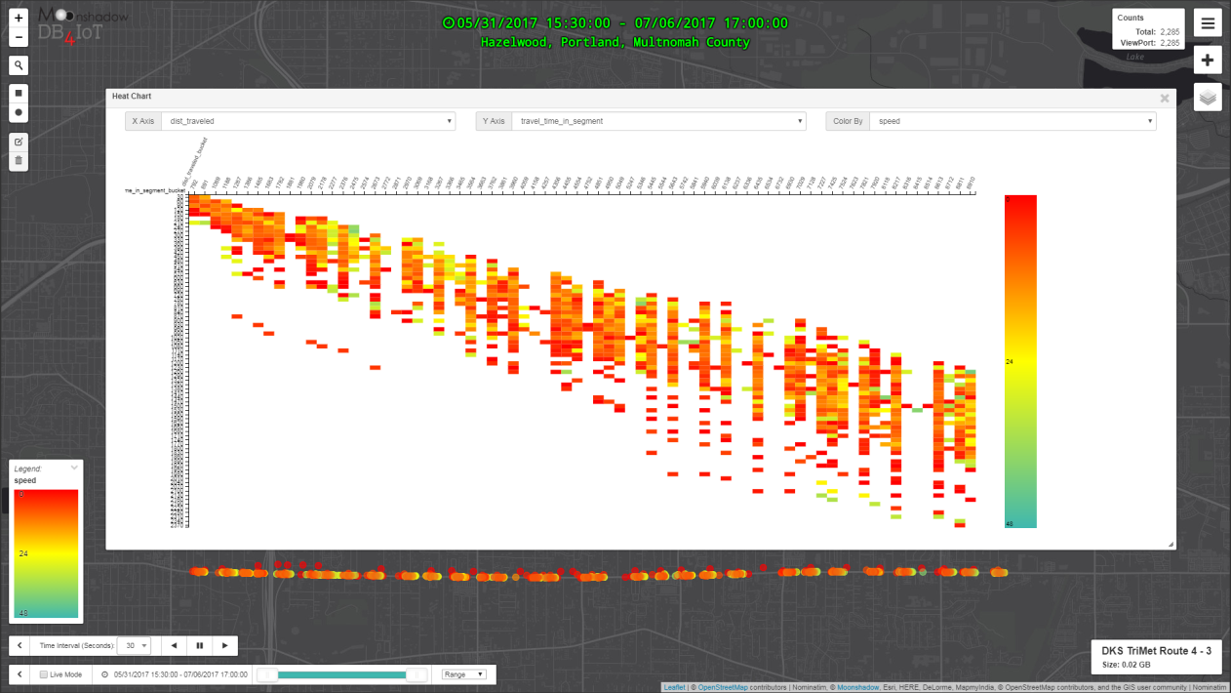
Corridor Studies: Model Calibration
NoBuild Vissim Model
Speed Map & Graph
Actual Measurements
Speed Map & Graph

Slide 28
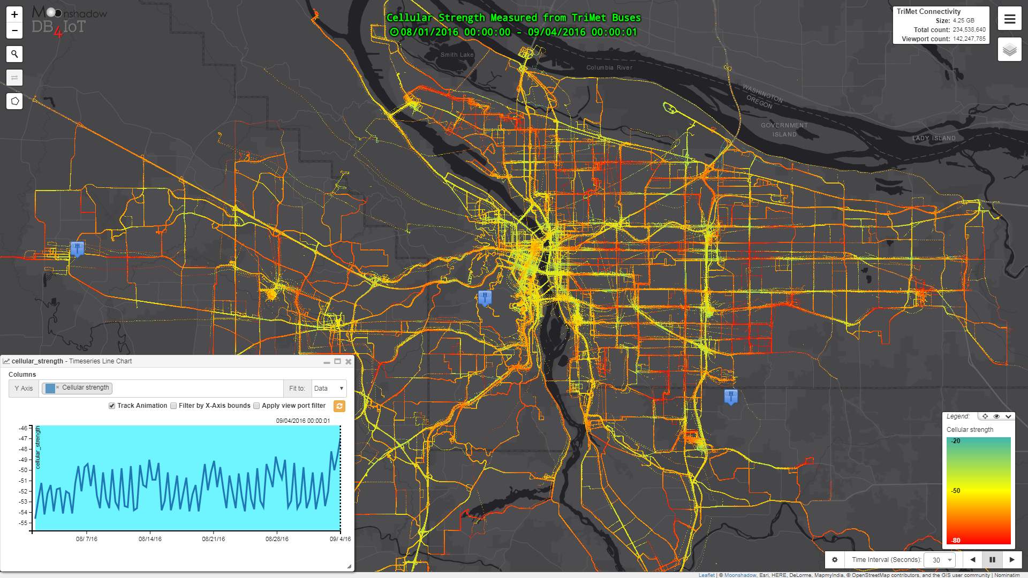
Cellular Signal Performance

Slide 29
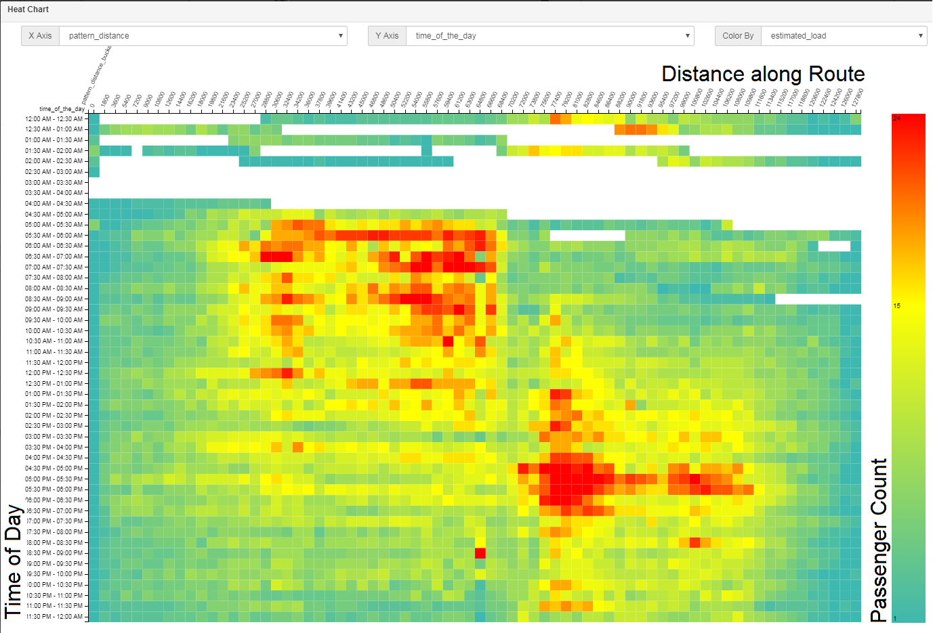
Ridership Analysis

Slide 30
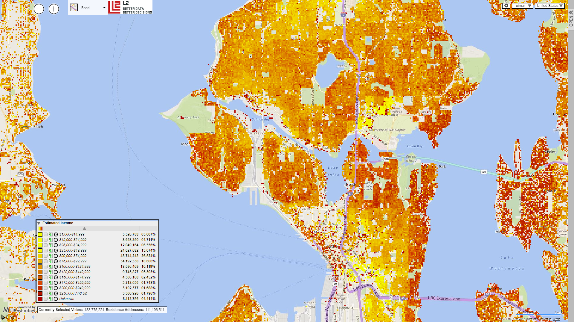
Social Equity: Income Distribution

Slide 31
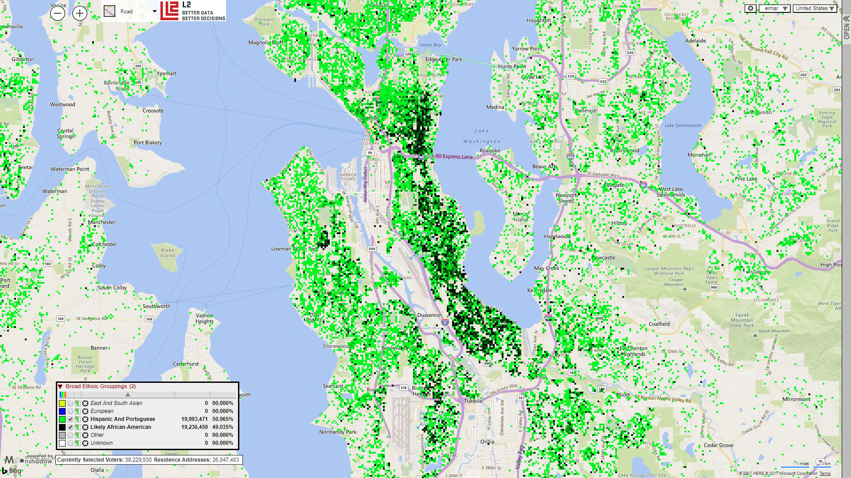
Social Equity: Minority Distribution

Slide 32
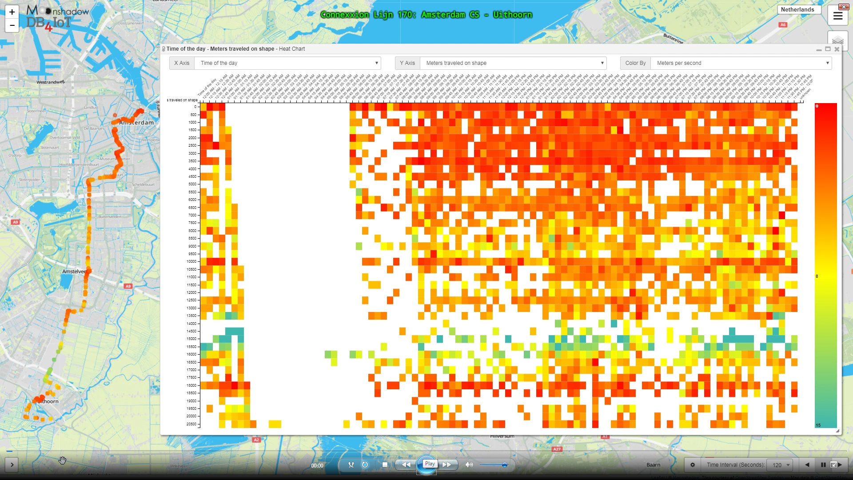
Route Analyst is Fast & Easy to Use
Click on this image to launch YouTube video

Slide 33
Thanks!
Route Analyst was developed by Moonshadow Mobile
in close cooperation with
consultants from DKS Associates
& data engineers from TriMet

Slide 34
Contact Info
Moonshadow Mobile, Inc.
Eimar Boesjes – CEO
eimar@moonshadowmobile.com
541-343-4281
moonshadowmobile.com
db4iot.com

