Slide 1
Analyzing Public Transit Data
Eimar Boesjes
CEO, Moonshadow Mobile, Inc.

Slide 2
IoT: The Internet of Things
IoMT: The Internet of Moving Things
Examples:
Buses
Trains
Light Rail
Driver Mobile Apps
Passenger Mobile Apps

Slide 3
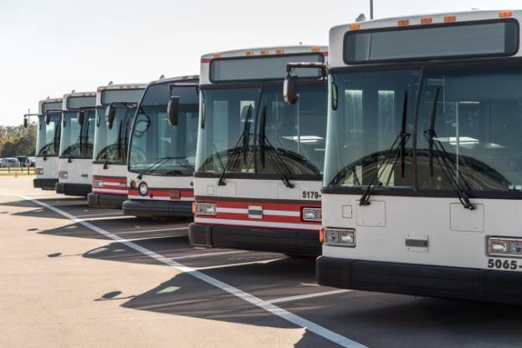
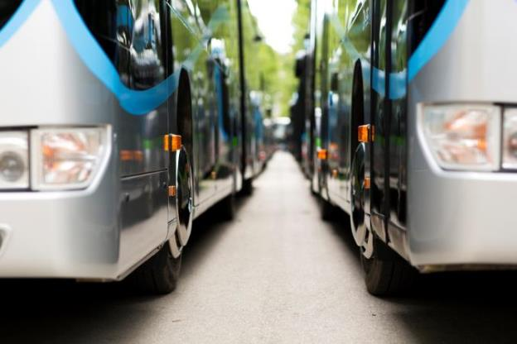
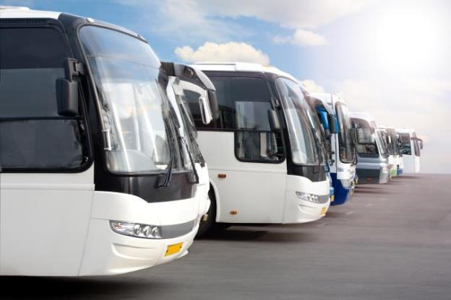
How TriMet Collects Data:
Real-Time and Daily
Sensors
Gateway
Computer
Time, Location, Delay
Acceleration, Speed
Breaking, Lane Changes
Passenger Counts
Engine Diagnostics
Some data is transmitted from the buses in real time via a radio or cellular connection
Most of the data is stored on a computer located in the bus and uploaded once per day

Slide 4
IoMT Isn’t Big Data, It’s Bigger Data
TriMet Example
One Month of Data
700 buses
145 light rail
300,000 weekday trips
100 million trips/year
400,000 daily stops
200 values per bus
Measured every five seconds
Stored in 30,000 daily log files
Comprising 250 million records
Containing 50 billion values

Slide 5
IoMT Isn’t Big Data, It’s Bigger Data
Vehicle Movement Data
60 MPH = 1 mile/minute = 27 meters/second
For <1 meter movement resolution, you need 50 measurements/second
Now TriMet’s one-month bus movement database is 60 Billion Records
1 Month of TriMet Bus Data = 1TB in DB4IoT
That is for only 845 vehicles

Slide 6
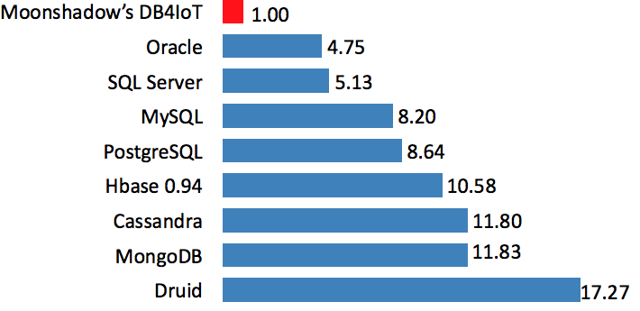
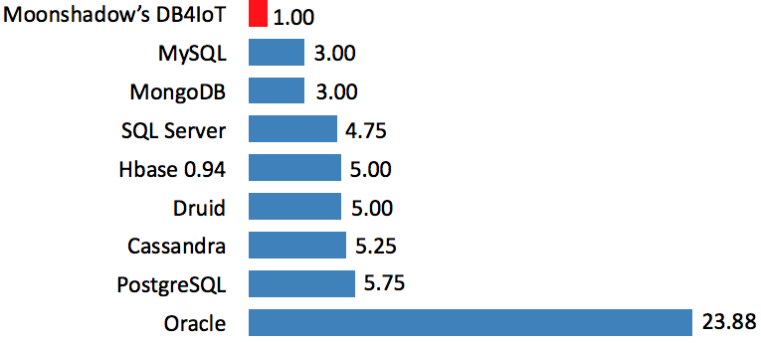
The Solution: Make Big Data Small
Data Footprint Size
Data Row Overhead Size

Slide 7
The Solution: Make Big Data Fast & Easy
High data ingestion rate | 100k updates/second/server
Super efficient data storage | <1 byte/value
High speed searches | 200M records/cpu/second
Software as a Service | Requires no Hardware Purchases
Software as a Service | Requires no Technical Staff
Instant maps | Map 200M records 10x per second
Easy Integration | Does not replace existing systems

Slide 8
Storing, Retrieving and Analyzing Data
Real-Time
Vehicle Data
ITS Fleet
Daily Log Files
Modelling
Data
Mobile App
Data
Cellular & Radio
Wi-Fi
Internet
Cellular
API
API
API
DB4IoT Mapped GUI
Dashboards
Customer Applications

Slide 9
Examples:
How Internet of Moving Things
Data Analytics and Visualization
Delivers Important Benefits
Data Source: TriMet

Slide 10
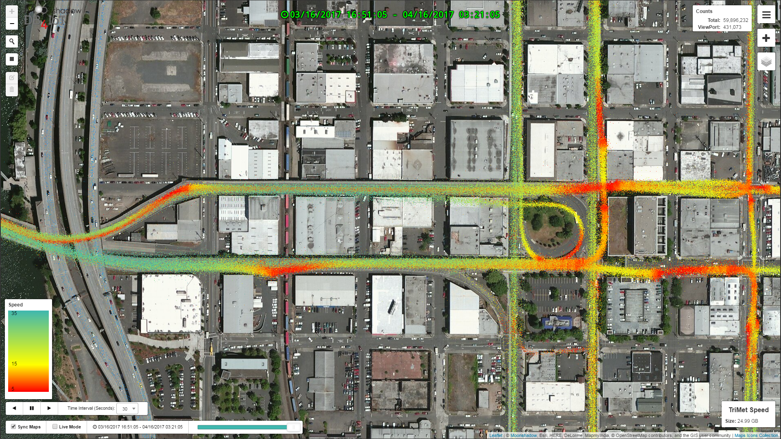
Vehicle Speed Data: Every Dot is a Bus Recording
Data Source: TriMet

Slide 11
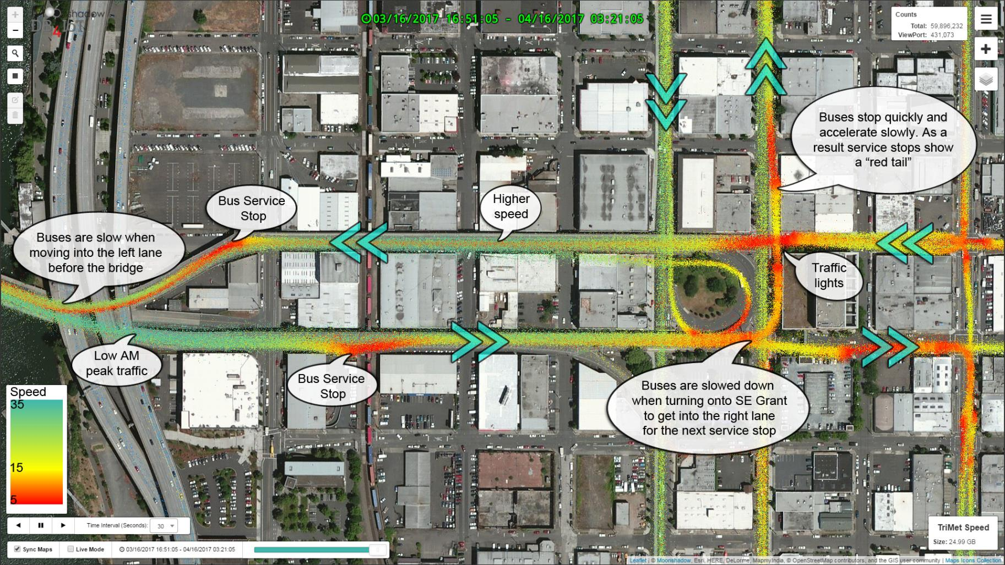
Conclusions from the Vehicle Speed Data
Data Source: TriMet

Slide 12
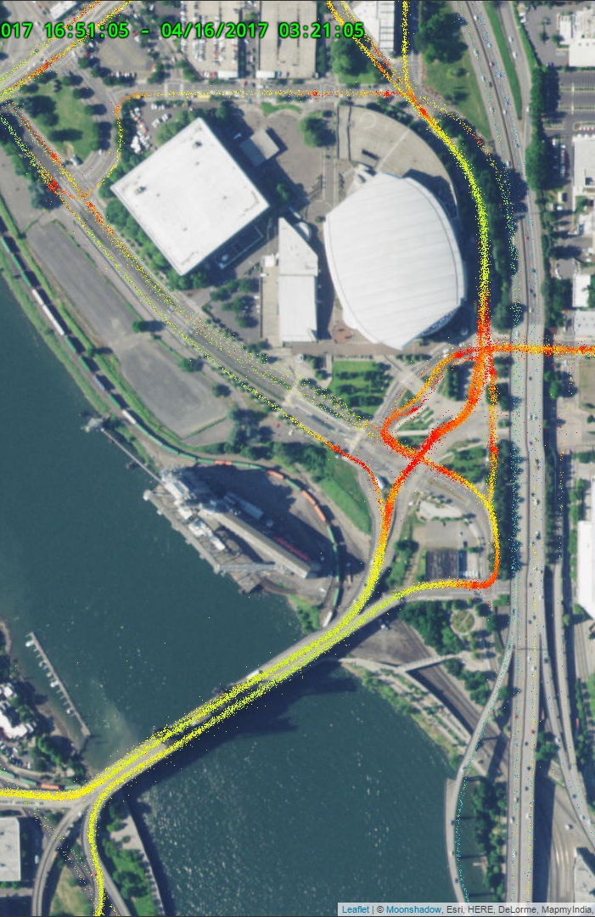
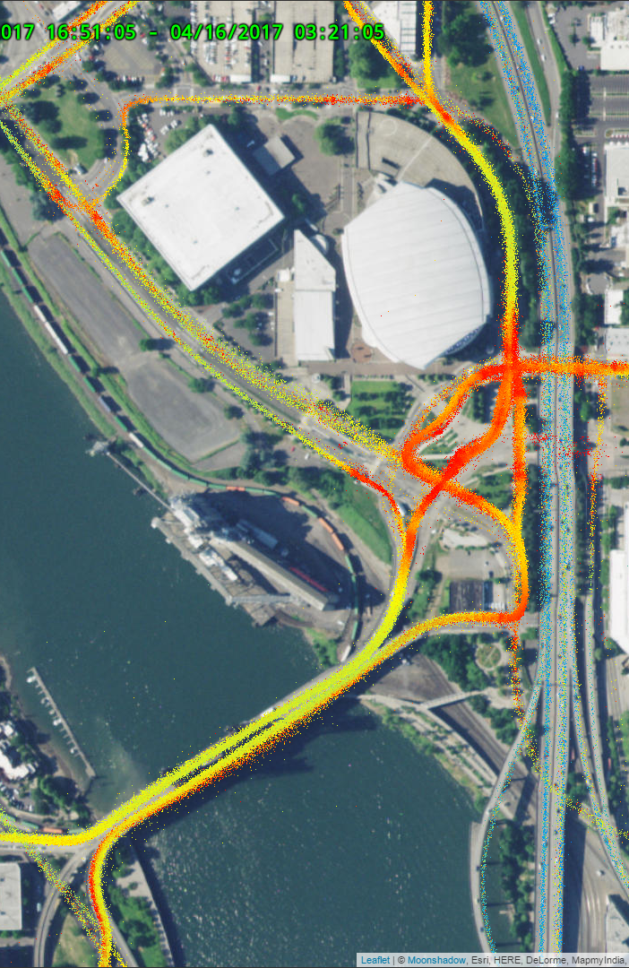
Comparing Time Periods
AM Peak
Midday
PM Peak

Slide 13
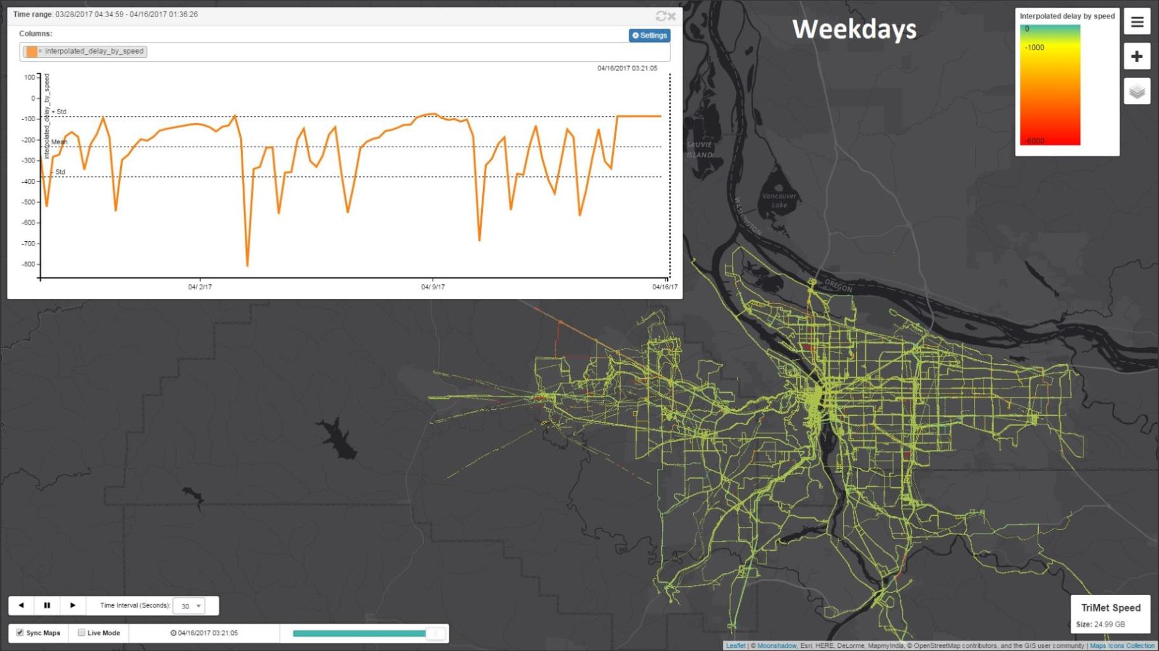
Delays for One Month on Weekdays
The Graph shows delays over time.
The Map
shows delays over space.
Data Source: TriMet

Slide 14
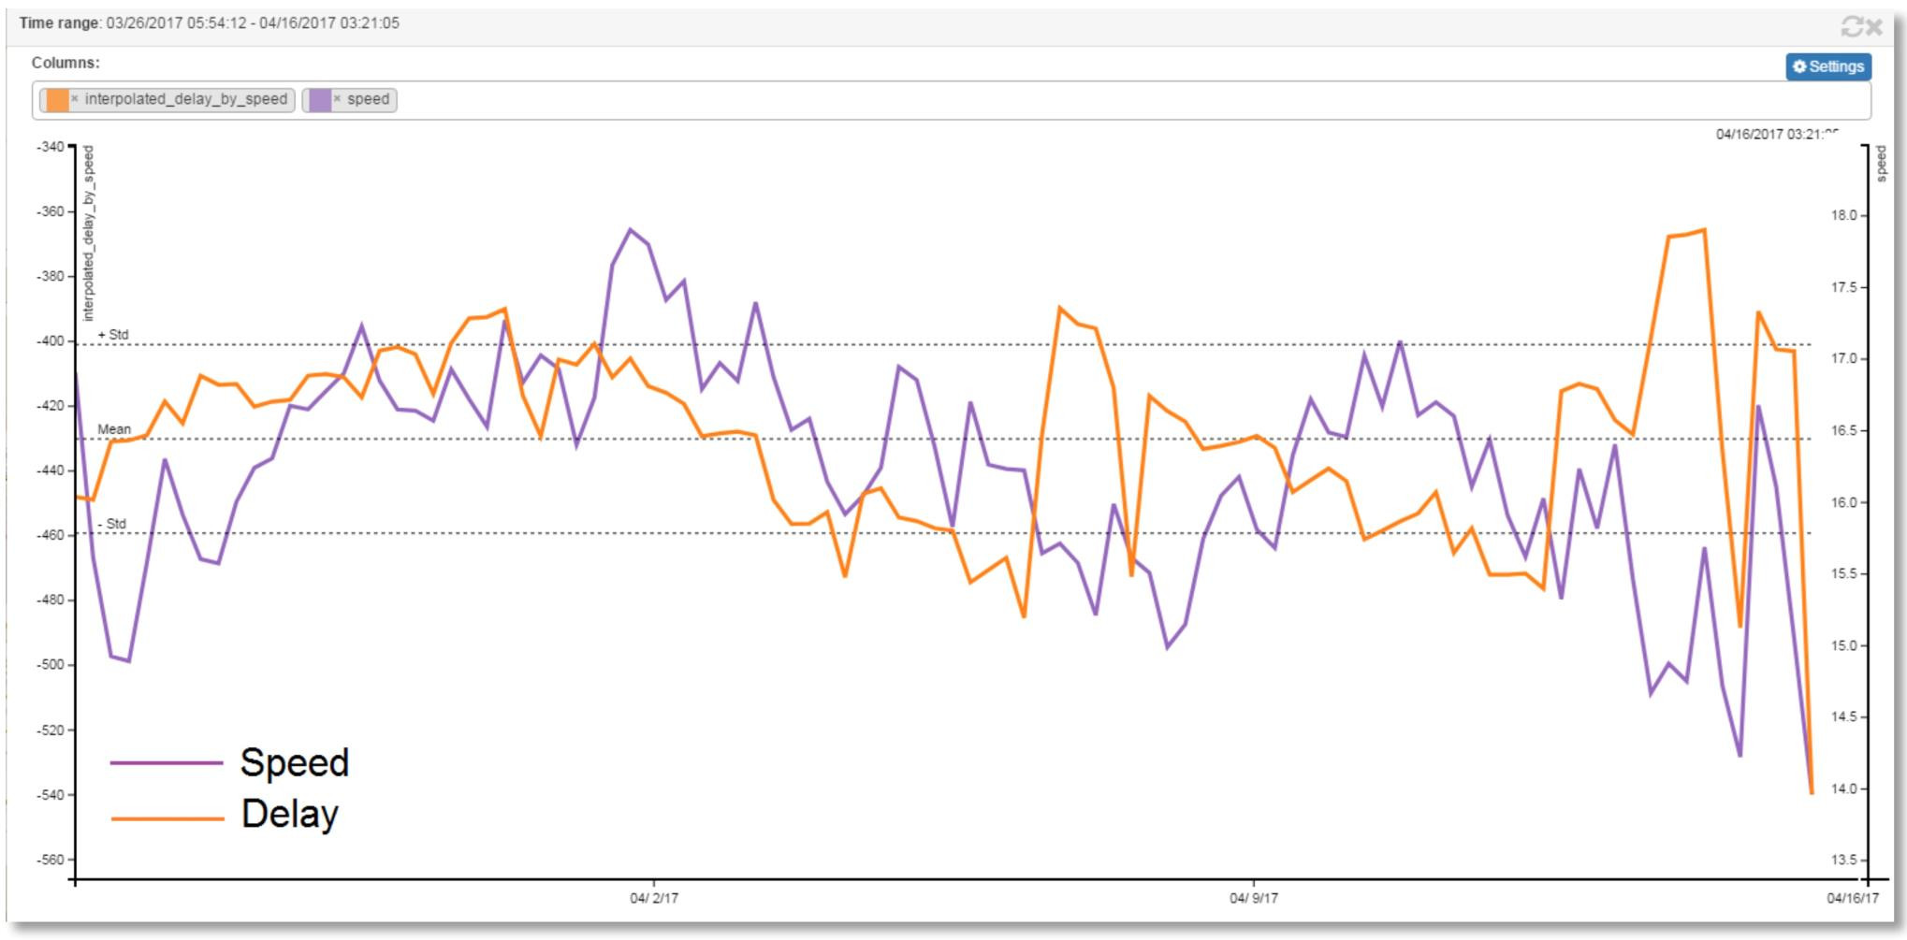
Comparing Speed and Delay over Time
Data Source: TriMet

Slide 15
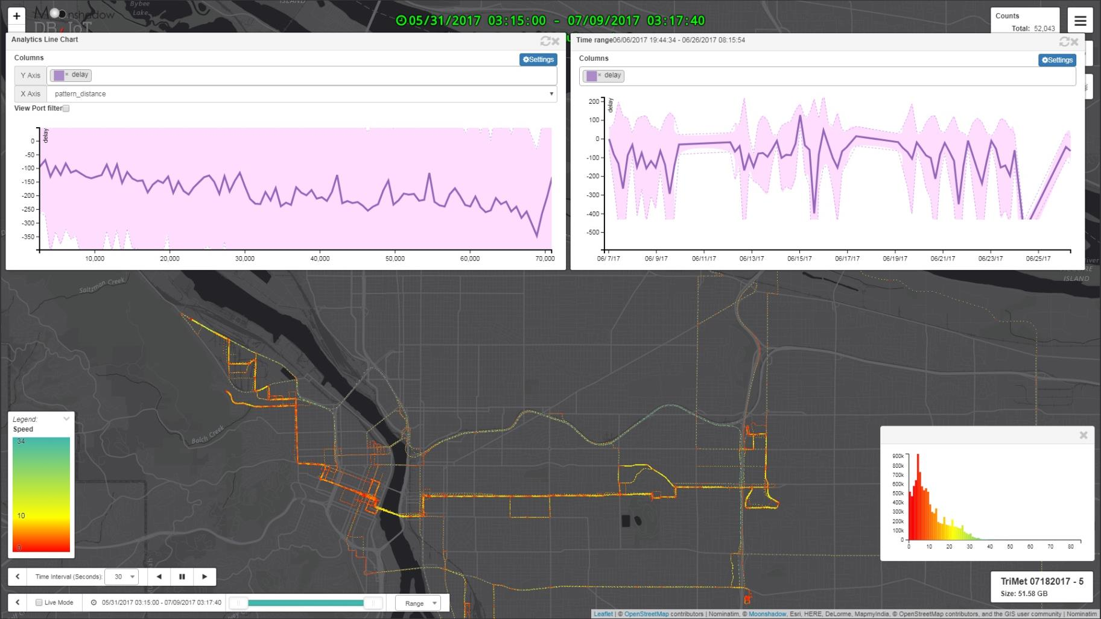
Route Delay by Route Distance
Showing the service delay on a time graph and a distance graph gives detailed information about the service on a route.
TriMet Route 15 Eastbound
Data Source: TriMet

Slide 16
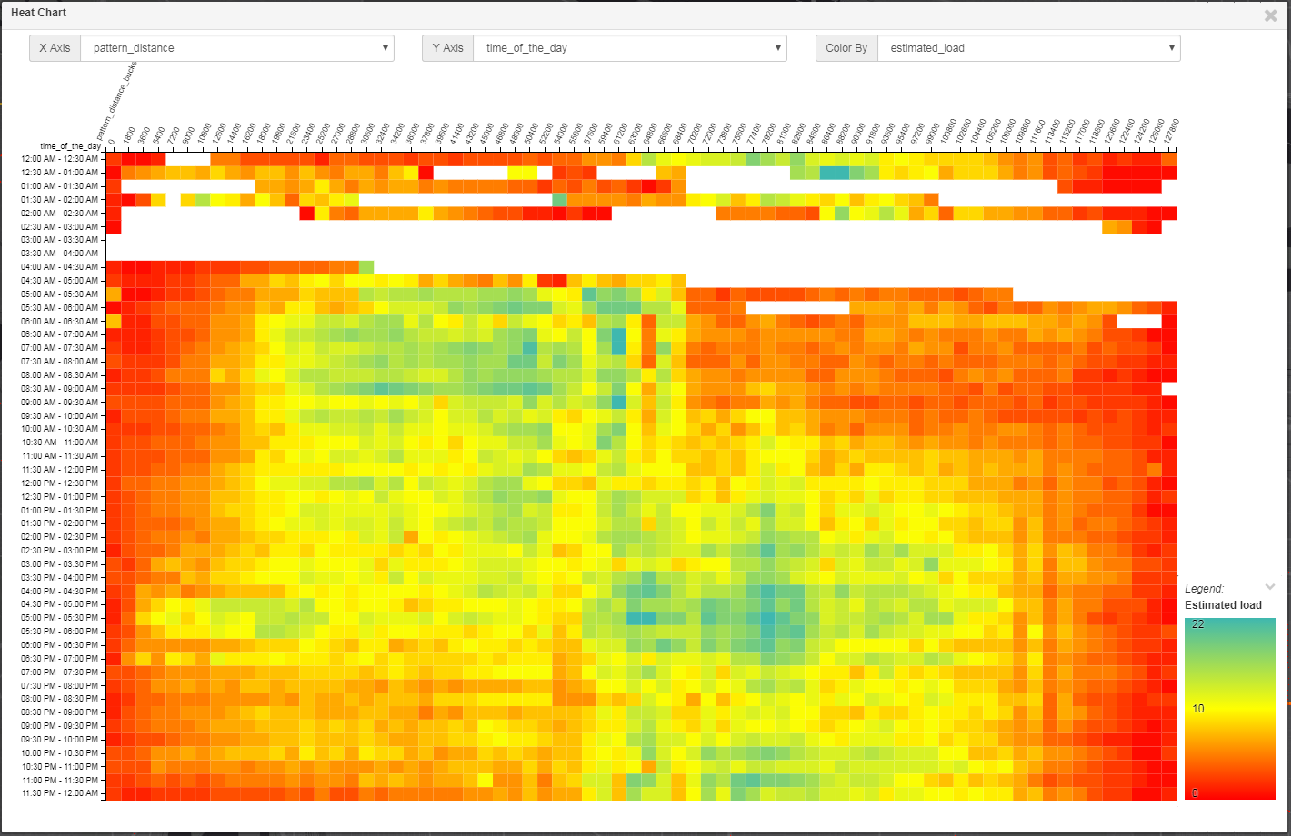
Passenger Count by Time of Day and Route Distance
TriMet Route 4 Eastbound Weekdays
Time of Day >>>>
Distance along route >>>>
Data Source: TriMet

Slide 17
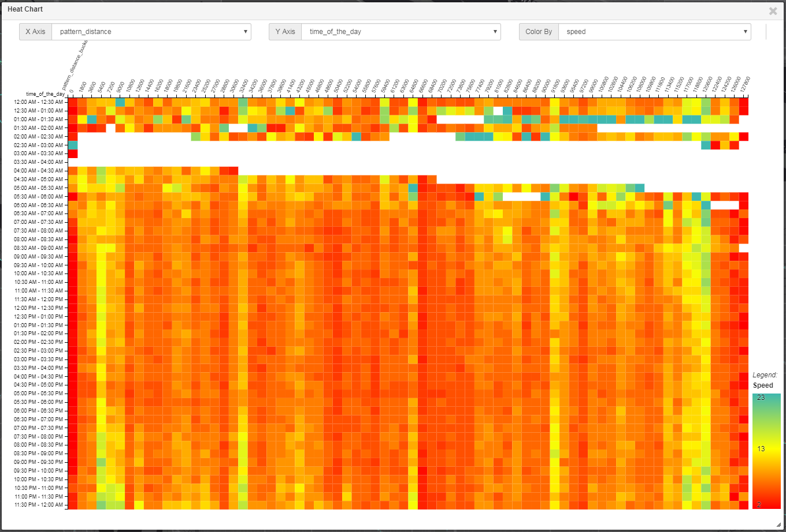
Speed by Time of Day and Route Distance
TriMet Route 4 Eastbound Weekdays
Time of Day >>>>
Distance along route >>>>
Data Source: TriMet

Slide 18
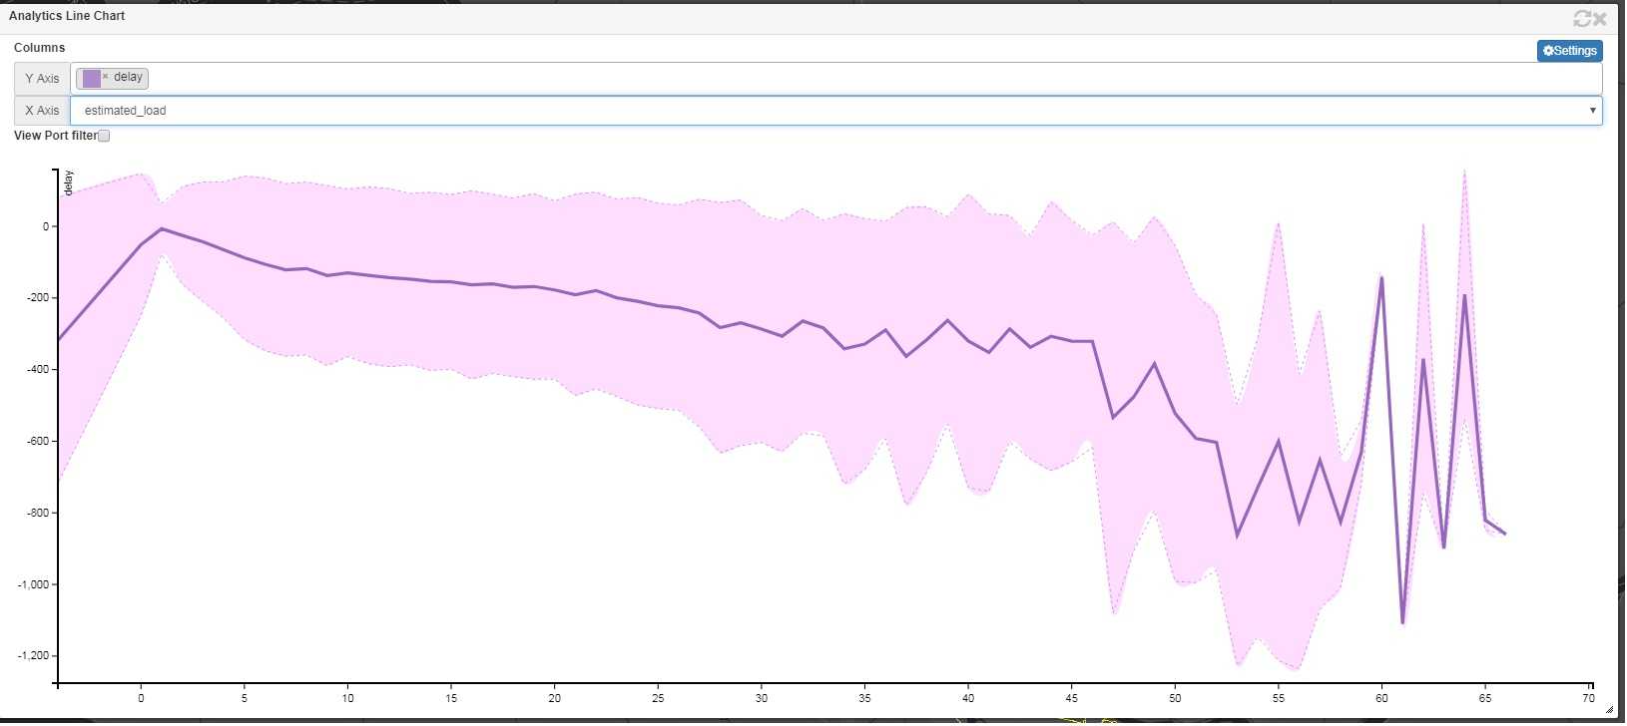
Bus Delay Versus Passenger Count
These images show how Delay increases as the
Estimated Load (number of passengers) increases.
Routenumber 15 Eastbound by Estimated Load
Data Source: TriMet

Slide 19
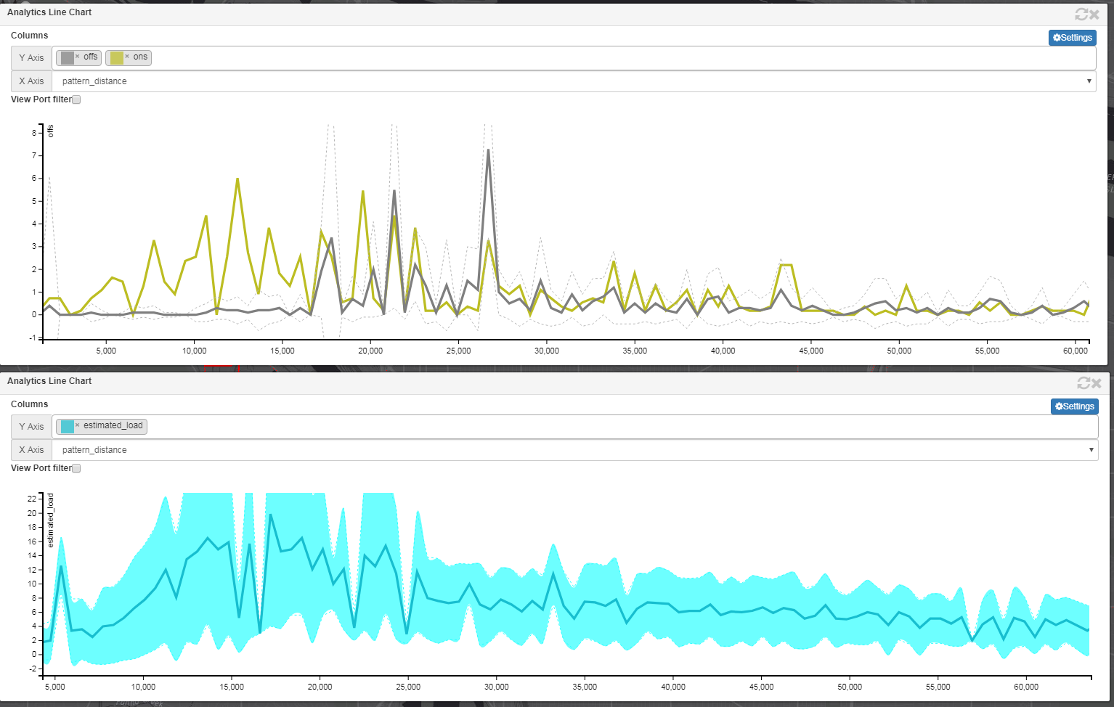
Passenger Boarding and Alighting
Routenumber 15 Eastbound Morning Peak
Data Source: TriMet

Slide 20
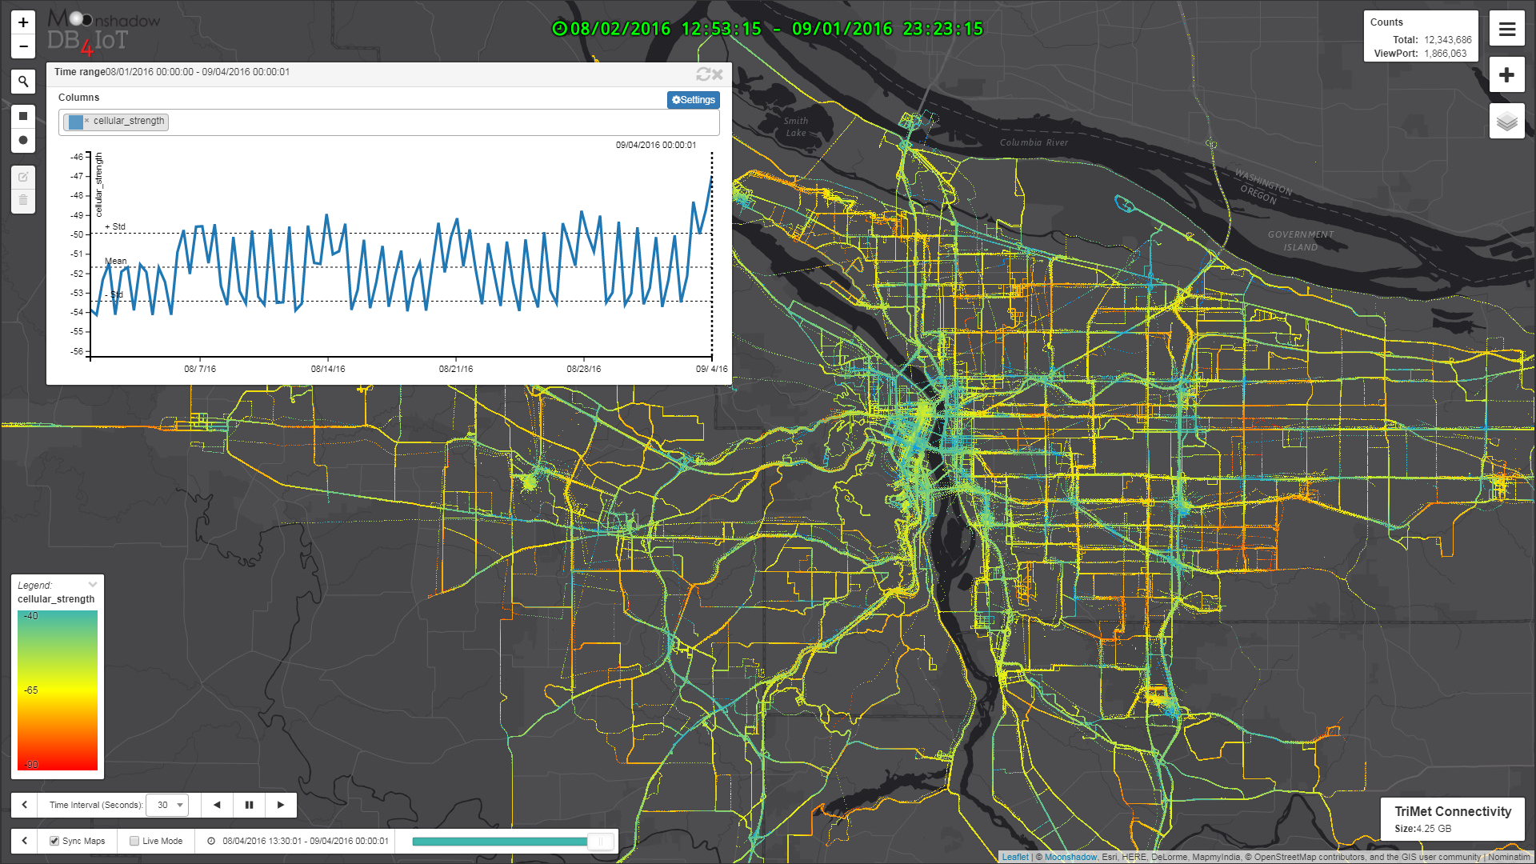
Cellular Connectivity over One Month
Data Source: TriMet

Slide 21
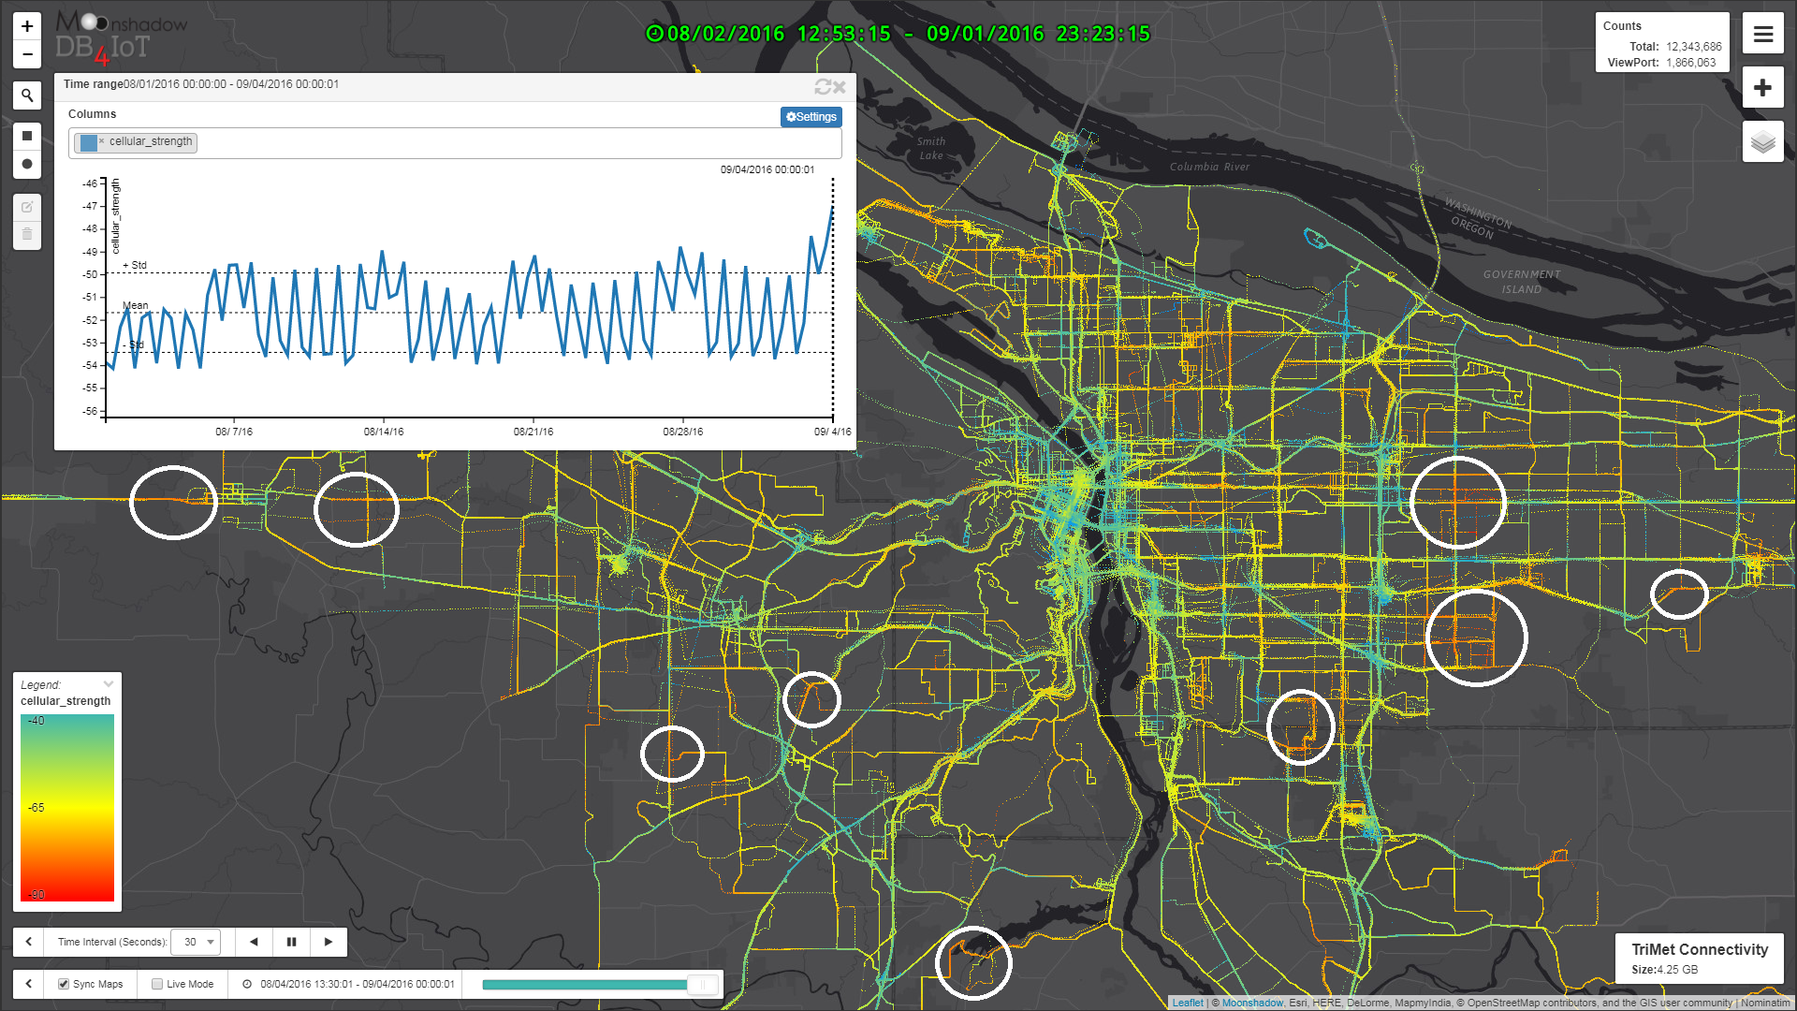
Cellular Connectivity: Bad Areas
Data Source: TriMet

Slide 22
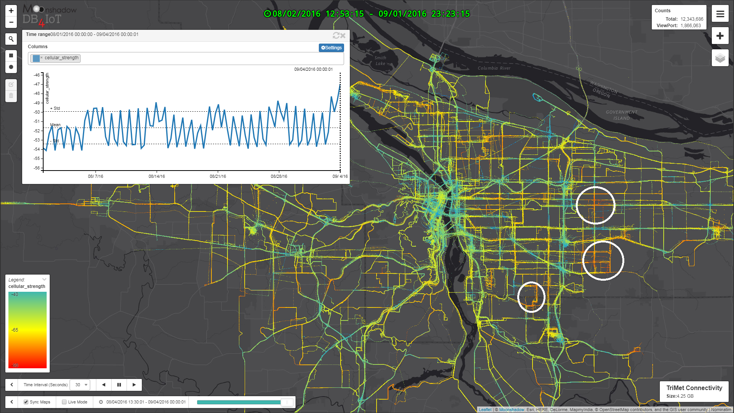
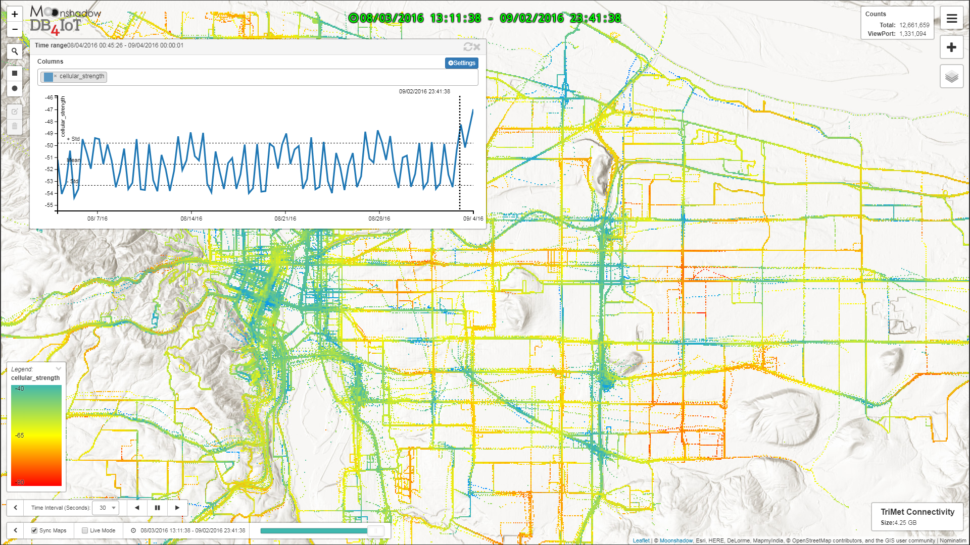
Comparing Connectivity with Geography
Data Source: TriMet

Slide 23
IoMT Data is Bigger Data
Leveraging IoMT Data
Provides Insights, Breakthroughs and Solutions
for Building Livable Communities with Public Transit

Slide 24
Thank You
Technology
Data
Consultant
Moonshadow Mobile, Inc.
Eimar Boesjes – CEO
eimar@moonshadowmobile.com
541-343-4281
moonshadowmobile.com
db4iot.com

