Slide 1
Tracking Down ITS Data Errors
Eimar Boesjes, CEO
Moonshadow Mobile, Inc.
eimar@moonshadow.com

Slide 2
Let’s start with a Simple Question:
How long does it take my bus to run this route?

Slide 3
The answer is not so simple because of . . . traffic
Traffic is affected by:
Day Type
Time of Day
Construction
Accidents
Holidays
Events

Slide 4
To get detailed information on run times
we often put riders on buses to time a route.
The Drawbacks:
Expensive
Time Consuming
Is the data representative?
You can’t go back in time

Slide 5
We already collect detailed information on run times
in our CAD/AVL systems.
The data is free
The data is representative
You can go back in time
You can do before, during and after comparisons
But . . .

Slide 6
CAD/AVL data contains massive errors.
If you can filter out the errors
it provides a wealth of information.
At Moonshadow we work with CAD/AVL data from dozens of agencies comprising billions of records.
In this presentation I’ll show some of the data errors and ways to identify and filter them.

Slide 7
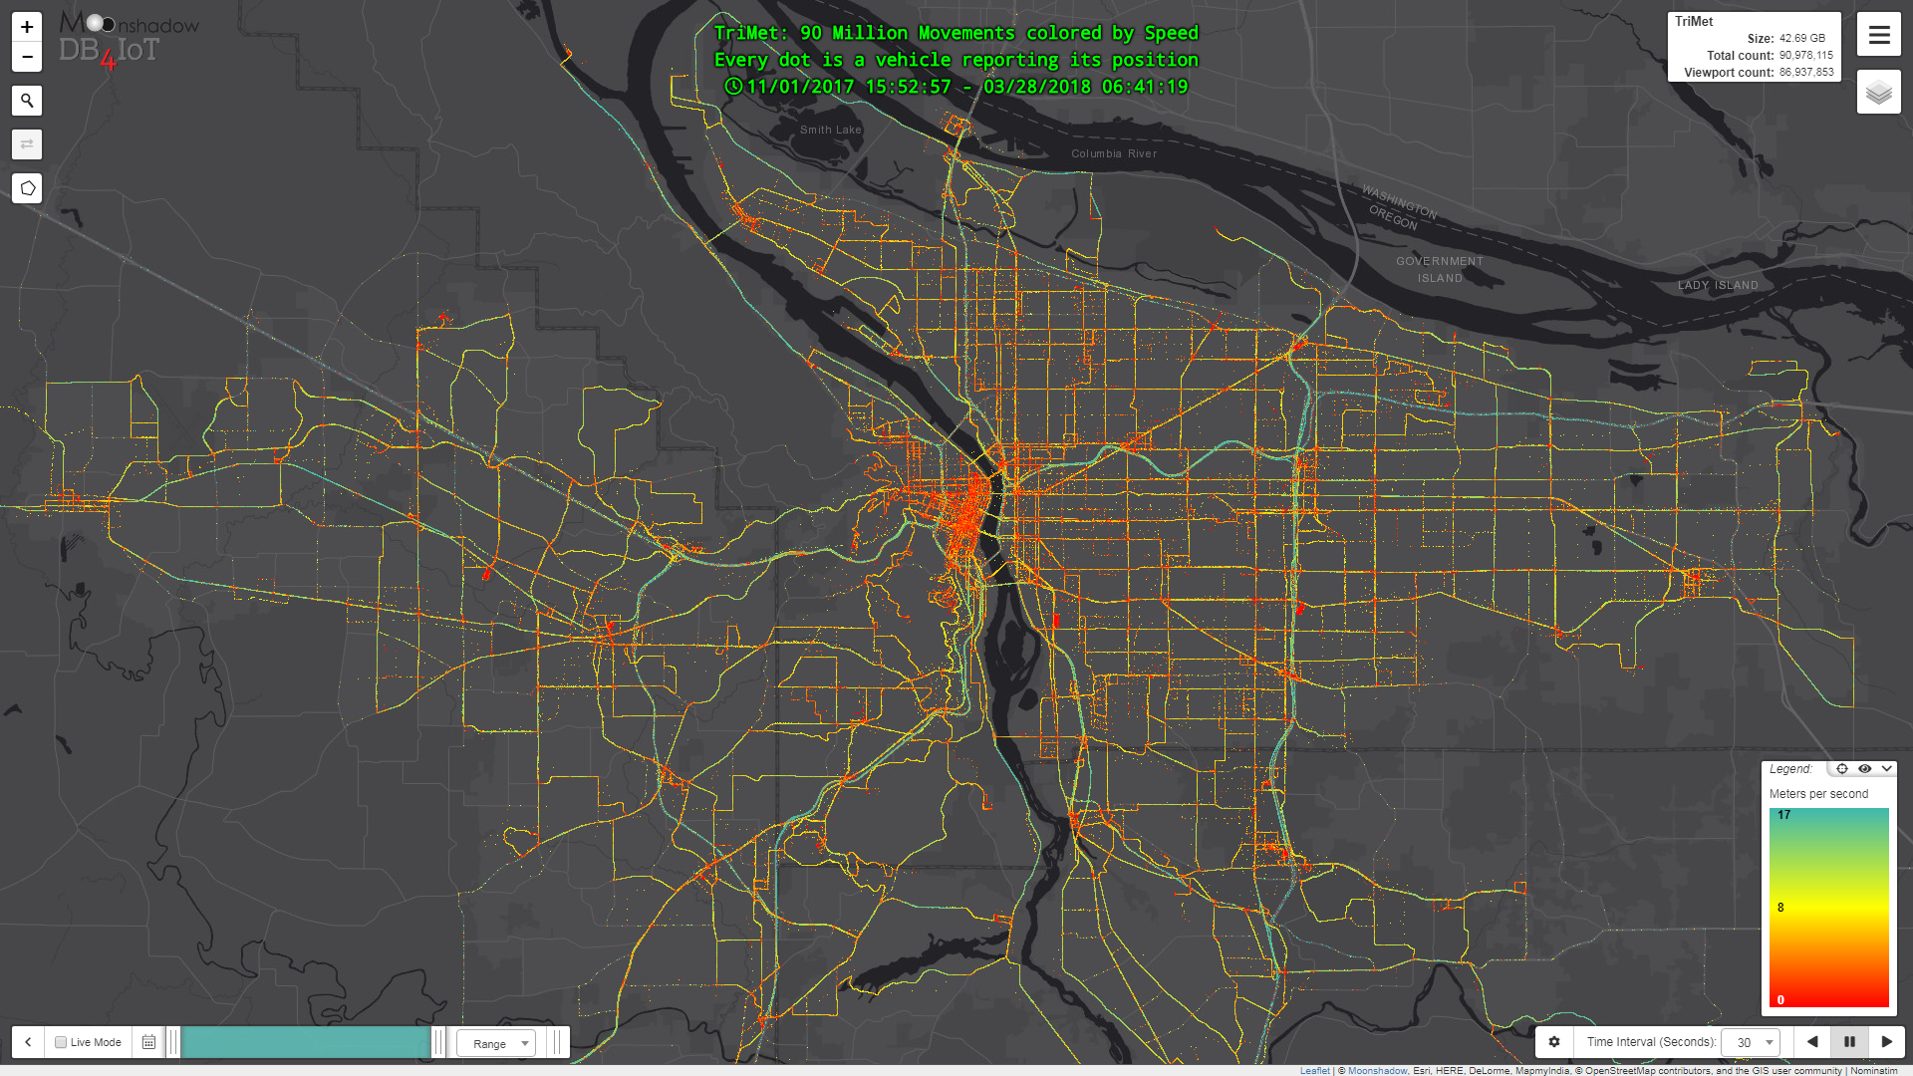
What does CAD/AVL data look like?

Slide 8
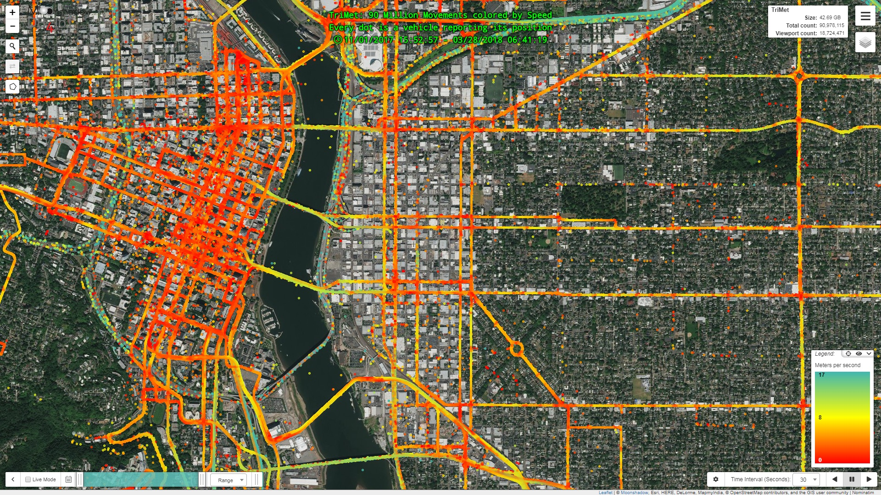
Every dot is a vehicle reporting its position

Slide 9
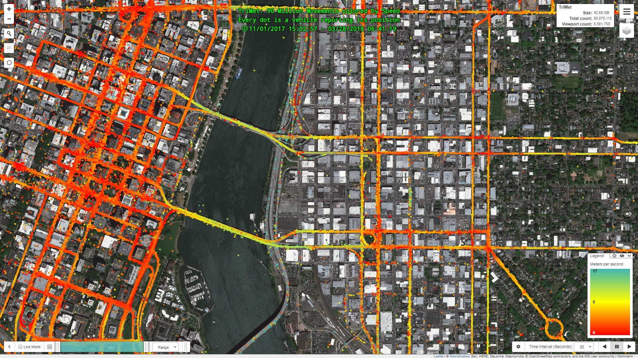
Every dot is a vehicle reporting its position

Slide 10
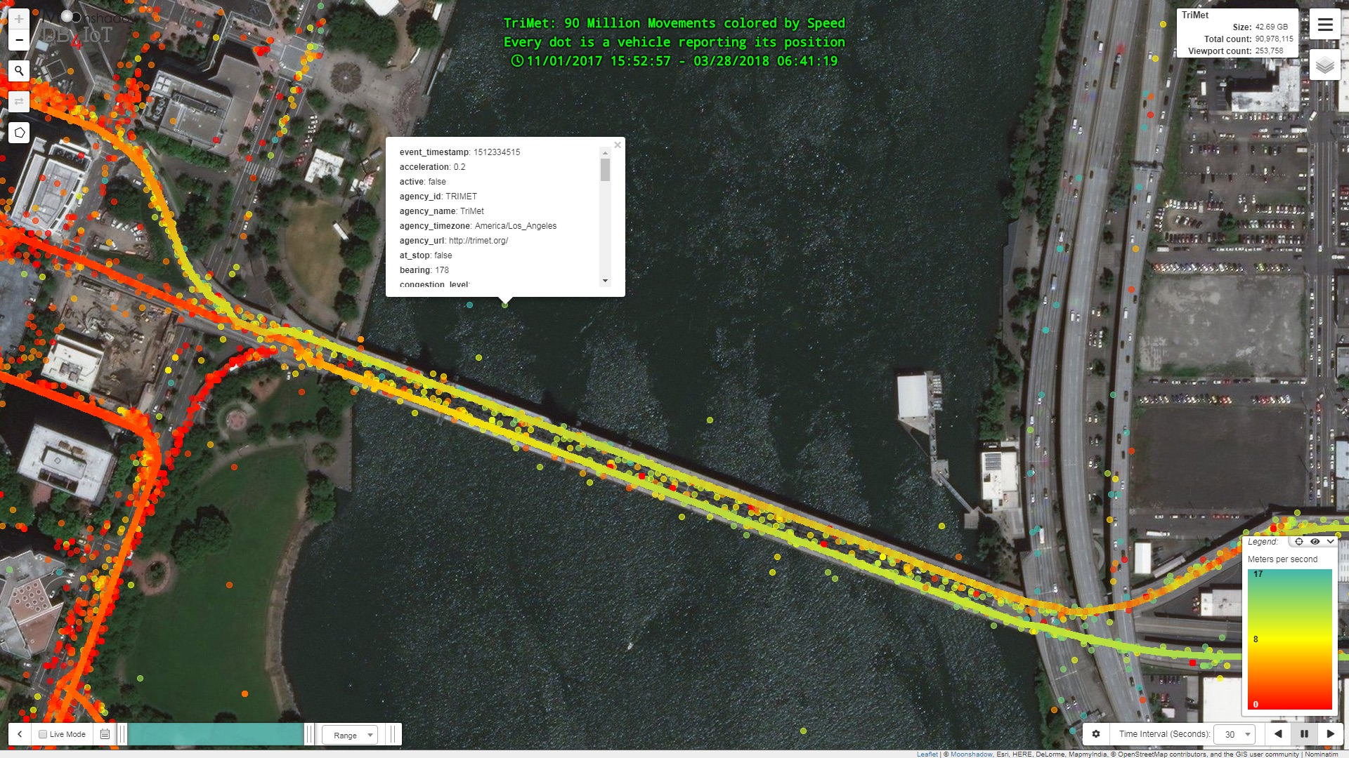
Every dot is a vehicle reporting its position

Slide 11
GPS Errors: Some buses are in the Willamette River

Slide 12
GPS Errors:
Unless you correct GPS errors
You can’t use the GPS data for distance
Therefore you can’t use the data for speed
You can still use the data for travel times

Slide 13
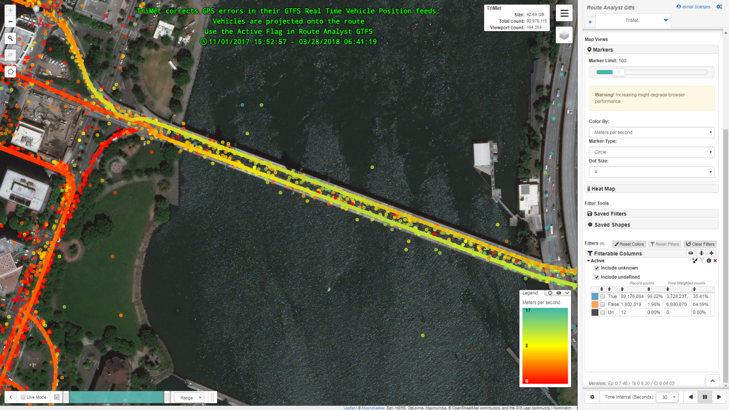
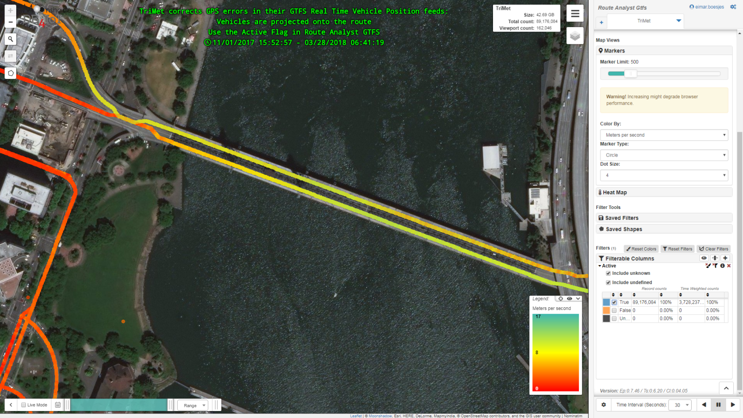
TriMet corrects GPS Errors
in their GTFS vehicle position feeds
Before correction

Slide 14
TriMet corrects GPS Errors
in their GTFS vehicle position feeds
After correction

Slide 15
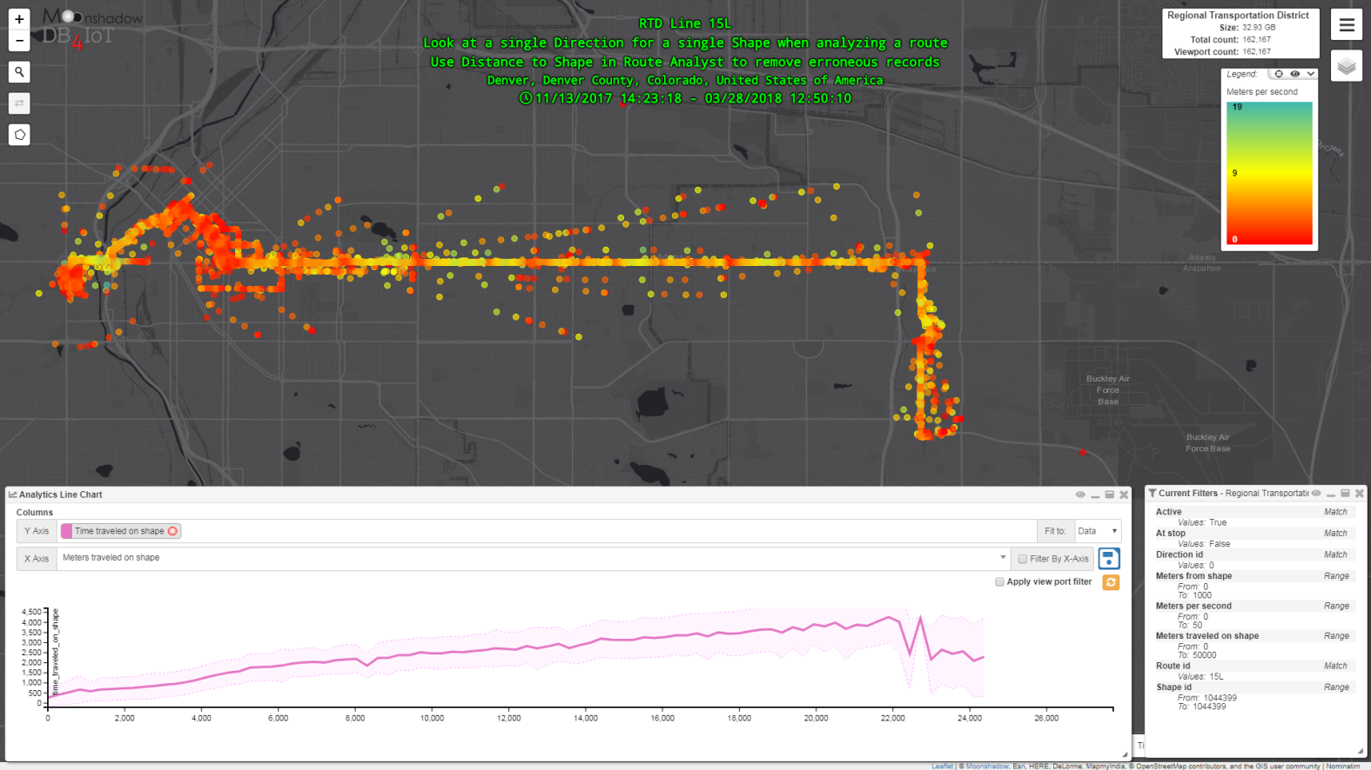
Erroneous records can be filtered out with distance to shape
Before filtering

Slide 16
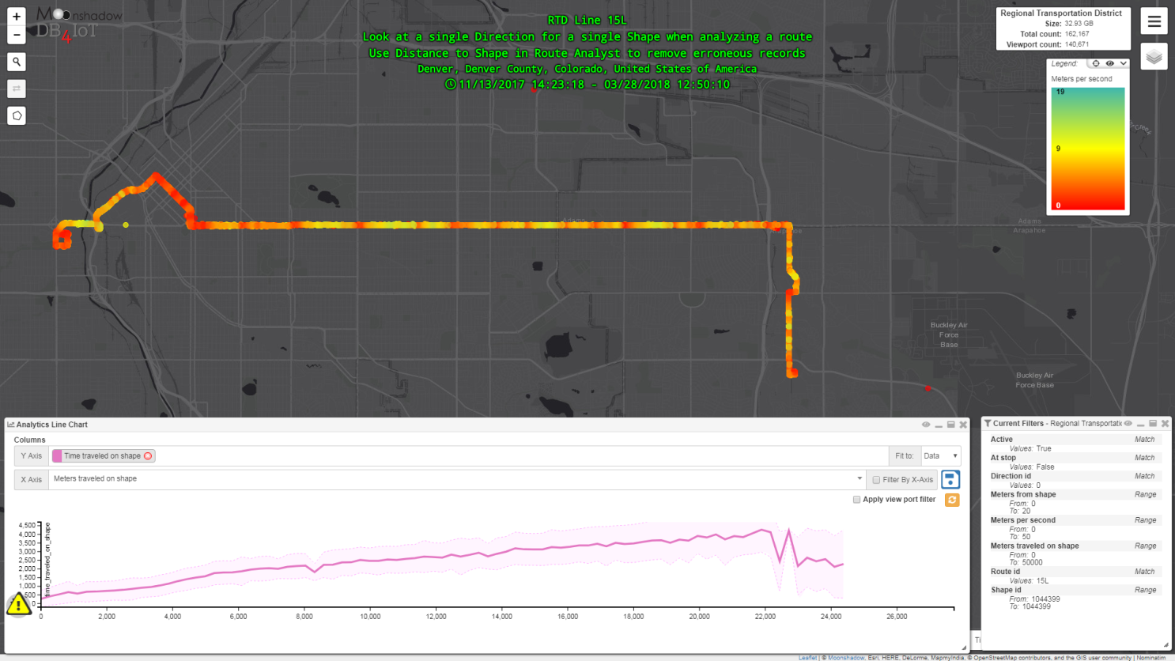
Erroneous records can be filtered out with distance to shape
After filtering

Slide 17
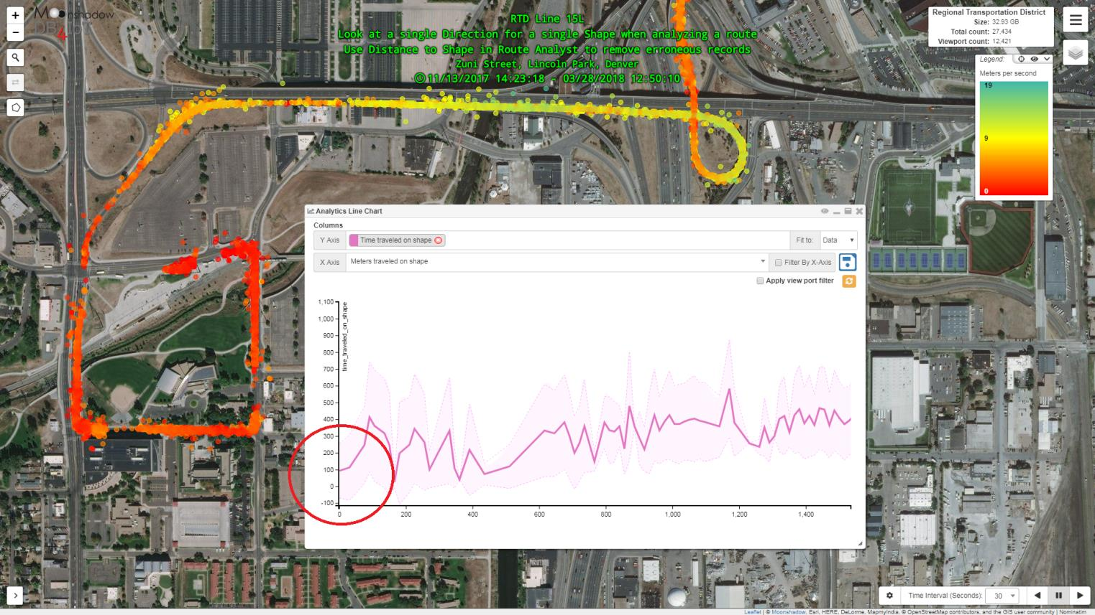
Route Logging is started too early
As a result the start time is not zero

Slide 18
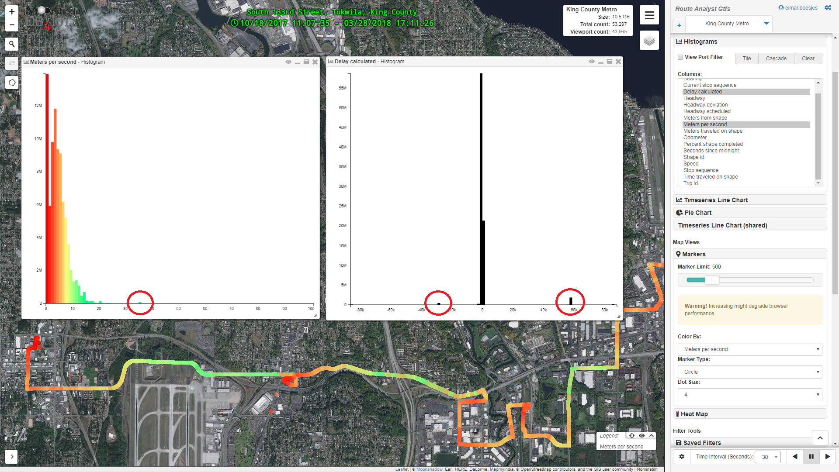
Histograms show outliers to filter out

Slide 19
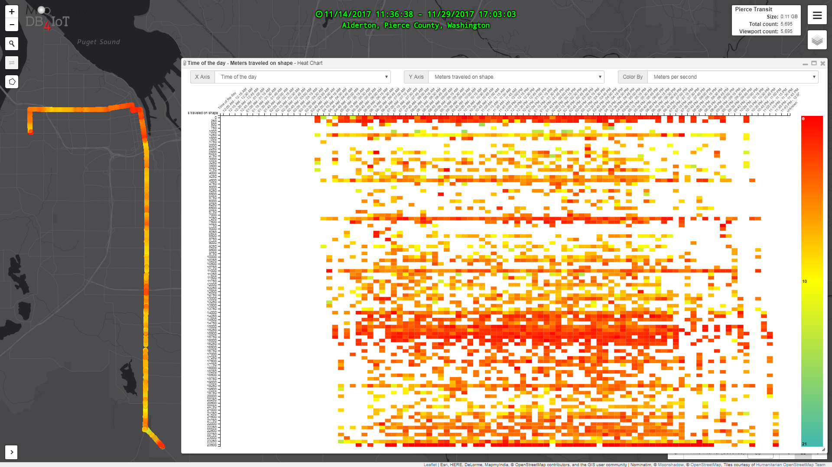
White Space = No Data
CAD/AVL Systems don’t report 30 seconds after service stops

Slide 20
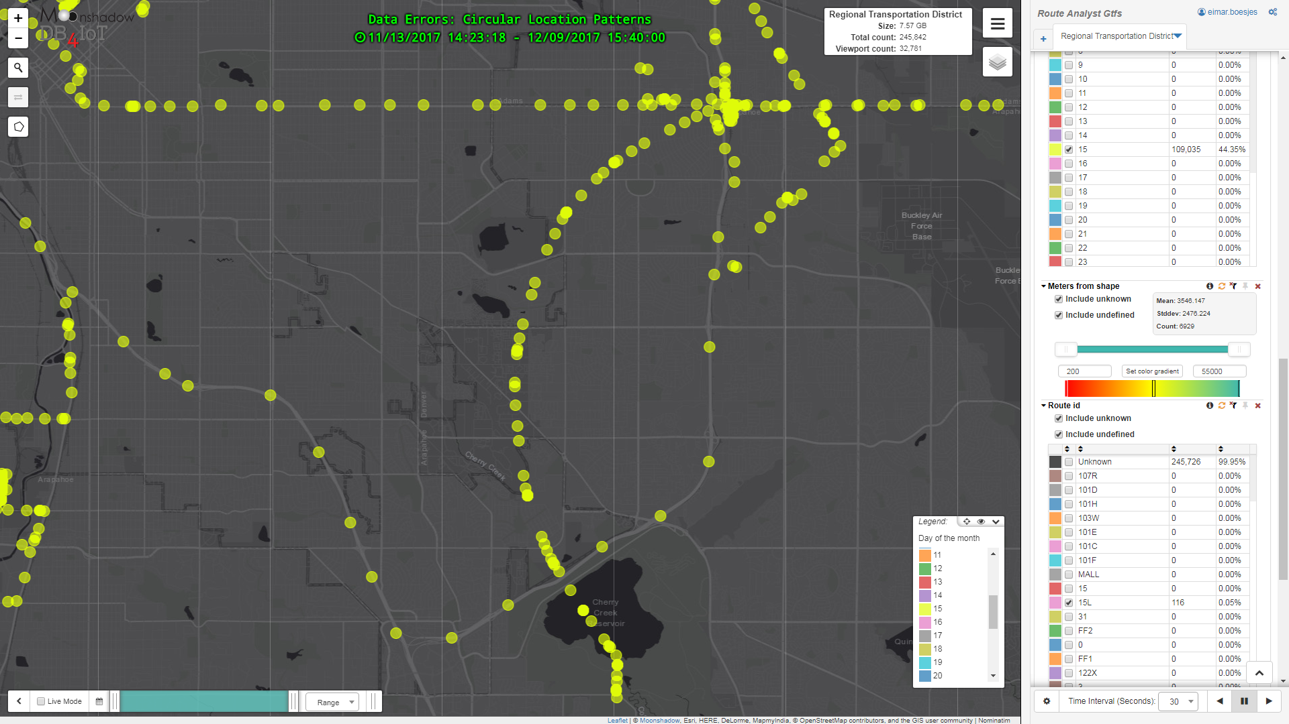
Data Errors: Circular Patterns
Patterns become clear only when the data is mapped

Slide 21
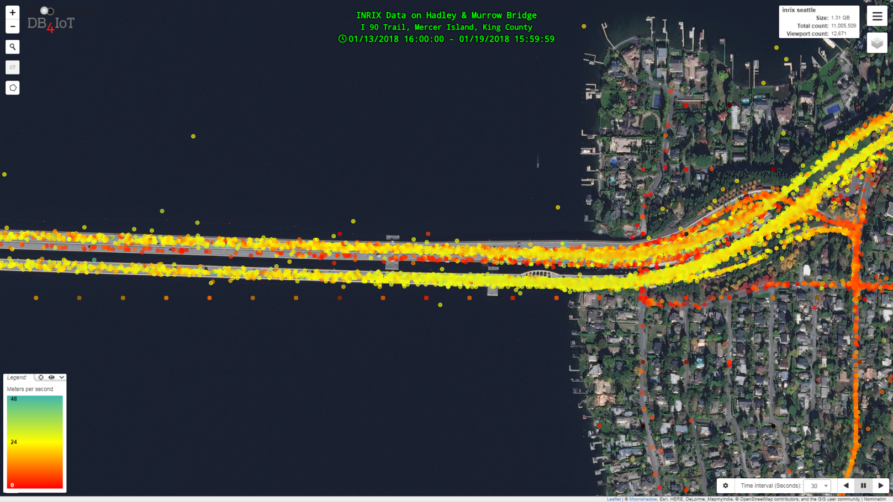
INRIX Data shows traffic is slow on the Westbound left lane
Are these data errors?

Slide 22
The Westbound left lane is under construction
and we’re seeing construction traffic.

Slide 23
When analyzing data
always know the local situation

Slide 24
We started with a Simple Question:
How long does it take my bus to run this route?

Slide 25
We know how long it takes to run a route:
At any time of the day
on weekdays or weekends
before, during and after construction.
We can see when and where delays are incurred,
buses are speeding to catch up
or traffic is slowing down service.

Slide 26
CAD/AVL Data can provide a wealth of information
However,
Drawing conclusions from CAD/AVL data requires:
Public transit expertise
Big data expertise
Knowledge of the local situation
Data visualization to identify errors

Slide 27
Contact Info
Moonshadow Mobile, Inc.
Eimar Boesjes – CEO
eimar@moonshadowmobile.com
541-343-4281
moonshadowmobile.com
db4iot.com

